Slide 1
Bilingualism as a tool to investigate the mind and brain
Judith F. Kroll
Department of Psychology
Center for Language Science
Program in Linguistics
Pennsylvania State University
University Park, PA 16802 USA
E-mail: jfk7@psu.edu
October 3, 2013
Cambridge University, UK
Language Sciences in the 21st Century: The interdisciplinary challenge

Slide 2
Acknowledgments
Collaborators:
Teresa Bajo
Kinsey Bice
Susan Bobb
Cari Bogulski
Ingrid Christoffels
Dorothee Chwilla
Albert Costa
Annette De Groot
Franziska Dietz
Giuli Dussias
Melinda Fricke
Chip Gerfen
Tamar Gollan
David Green
Taomei Guo
Jason Gullifer
Noriko Hoshino
April Jacobs
Niels Janssen
Debra Jared
Sonja Kotz
Wido La Heij
Jared Linck
Fengyang Ma
Pedro Macizo
Mari Cruz Martín
Rhonda McClain
Erica Michael
Natasha Miller
Maya Misra
Jill Morford
Juliana Peters
Pilar Piñar
Eleonora Rossi
Rosa Sánchez-Casas
Ana Schwartz
Bianca Sumutka
Gretchen Sunderman
Natasha Tokowicz
Janet Van Hell
Zofia Wodniecka
Megan Zirnstein
Research Support:
NIH Grants MH62479 and HD053146; NIH Fellowship F33HD055003
NSF PIRE Grant, OISE-0968369: Bilingualism, mind, and brain
NSF Grants, BCS-0111734, BCS-0418071, BCS-0955090
NSF Dissertation Grants to Sunderman, Schwartz, McClain, Hoshino, Bobb, Bogulski, & Gullifer
Open Project Grant at State Key Laboratory for Cognitive Neuroscience and Learning,
Beijing Normal University, China
John Simon Guggenheim Memorial Foundation Fellowship, 2013-14

Slide 3
The Penn State Center for Language Science Bilingualism Network
Support from NSF PIRE (Partnerships for International Research and
Education): 2010-2015: Bilingualism, mind, and brain: An interdisciplinary
program in cognitive psychology, linguistics, and cognitive neuroscience

Slide 4
More people in the world are bilingual than monolingual.
But until very recently, most research on language and cognition
examined only monolingual speakers of a single language and
typically speakers of English as the native language.
Bilinguals were considered to be a “special” population.

Slide 5
Past research on language processing and its cognitive basis has typically assumed that monolingual speakers are the model subjects of study and that the native language alone provides an adequate basis on which universal principles might be generalized.
On this view, bilinguals have been considered a special group of language users, much like brain damaged patients, children with language disorders, or deaf individuals who use a signed language to communicate.
Each of these special groups holds genuine interest for the field but their performance is not necessarily taken to provide the primary source of evidence for the purpose of adjudicating the classic debates about the representation and processing of language in the mind and brain.

Slide 6
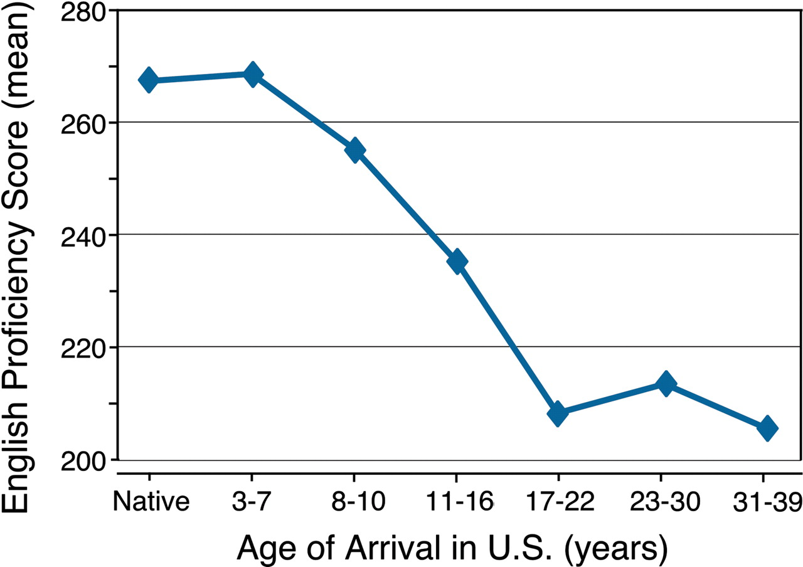
Why have bilinguals been considered special despite the large number
of people in the world who speak more than one language?
There are many reasons but a key observation is that learning an L2
past early childhood is a difficult task with mixed outcomes.
Even highly successful late L2 learners speak with an accent and
appear to fail to acquire subtle aspects of the L2 grammar.
Flege et al. (1995) Johnson & Newport (1989)

Slide 7
For these reasons, the evidence on bilingualism, particularly for late acquirers of an L2 has been taken by many to suggest that the L2 is fundamentally different and separate from the native language, with properties that are enabled by domain-general cognitive processes but constrained by the inability to access all of the linguistic representations typically associated with the native language.
On this (traditional) view:
Late bilinguals may indeed be special, with a mixed language system that includes a full native language and a funky L2
Bilinguals should be functionally monolingual in the native language
The L1 should transfer to the L2 but not much transfer would be expected
from the L2 to the L1

Slide 8
But that view has changed, in part as a consequence of the upsurge of research on bilingualism and L2 learning across the language science disciplines.
On the 125th anniversary of the journal Science, Kennedy and Norman (2005) identified the biological basis of second language (L2) learning as one of the top 125 questions to be answered in the next 25 years of research:
Research articles published on Second Language Acquisition and Bilingualism since 1985 (Web of Science)

Slide 9
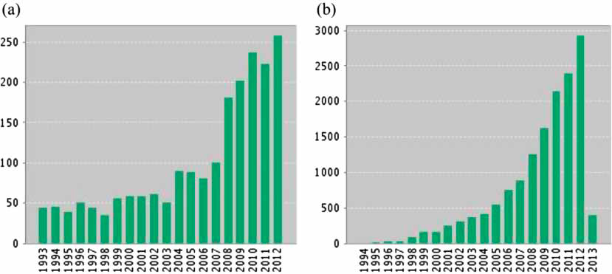
There has been a virtual explosion of research on bilingualism:
Figure 1. Results of search for topic ‘‘bilingualism’’ on Thompson-Reuters Web of Science for (a) number of papers published and
(b) number of citations of those papers for years 1993 to 2012.
(From Kroll & Bialystok, 2013, Journal of Cognitive Psychology)

Slide 10
What have we learned in the recent research?
Recent neuroscience evidence has called into question the presence of hard constraints on L2 learning; proficiency in L2 may be more important than age of acquisition (e.g., Abutalebi et al., 2005; Steinhauer et al., 2009).
Bilinguals may not be monolingual-like in their native language, but that does not make them special as language users. Instead, it suggests that the native language is open to change and to the influence of the L2 (e.g., Ameel et al., 2009)
Bilingualism and second language learning provide a lens for researchers to examine aspects of the underlying cognitive architecture that may be obscured by native language skill when investigating language performance in the first or dominant language only. We would not know these changes to the native language occur unless there was another language.
Bilingualism is a tool for cognitive scientists and cognitive neuroscientists

Slide 11
A word on terminology:
Bilinguals and Second Language (L2) Learners
We adopt a broad definition of bilingualism to include all individuals who use more than one language regularly.
We distinguish bilingual groups with respect to their proficiency in the L2, their relative language dominance, the age of acquisition, and the degree to which the context of language use supports each of the two languages.

Slide 12
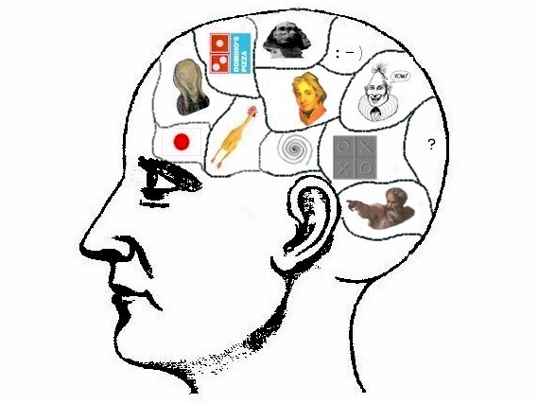
How do the mind and brain accommodate the presence of two languages? What does that tell us that we would not know if we studied only monolingual speakers?
The bilingual is a mental juggler: Both languages are active regardless of the requirement to use one language alone:
Dutch-English speaker
“bike”
“fiets”
How does a bilingual select a given language to be used at any moment?

Slide 13
Current research demonstrates that both of a bilingual’s languages are active regardless of the intention or requirement to use one language alone.
The parallel activity of the two languages is hypothesized to produce competition.
Skilled bilinguals rarely make the error of speaking the wrong language yet they often code switch with other similar bilinguals in the middle of a sentence, suggesting that they possess an exquisite mechanism of cognitive control.
A life of resolving cross-language competition appears to confer a range of positive consequences for cognition and changes to the brain networks that reflect the way in which control mechanisms are engaged.

Slide 14
And perhaps building cognitive reserve
to enable fluent performance

Slide 15
What is the consequence of parallel activity and competition
across the bilingual’s two languages?
The hypothesis is that juggling creates a need to negotiate
competition across the two languages so that the use of
each language is controlled to enable fluent performance.
These control processes may include inhibition of the L1
or more dominant language with enduring consequences
for native language use.
Skill in resolving cross-language competition is
hypothesized to create expertise that affects cognition
and the brain.

Slide 16
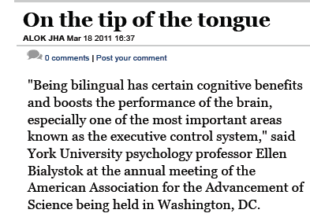

Slide 17
Bilingualism may offer protection against the normal declines in
attentional control associated with aging.
Bialystok et al. (2005): Older bilinguals outperform age-matched monolingual counterparts on the Simon Task and on other non-linguistic measures of inhibitory control.
Bialystok et al. (2007): Bilingualism delays the onset of
Alzheimers-type dementia by four years. Language experience may provide protection to the brain.

Slide 18
The Simon Task
Congruent Trials Incongruent Trials
“Press the button on the left for Red and button on the right for Green”

Slide 19
Bialystok et al. (2004): Magnitude of the Simon Effect by Decade:
How much do individuals suffer the consequences of incongruity?
Hypothesis: The bilingual advantage arises from a life of resolving competition across the two languages.

Slide 20
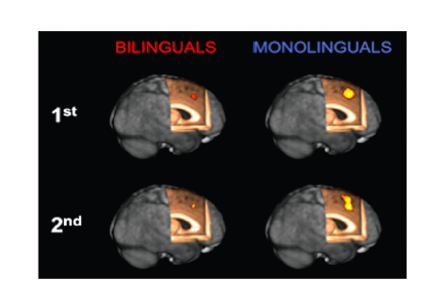
What is the neural basis of the bilingual effect in resolving conflict?

Slide 21
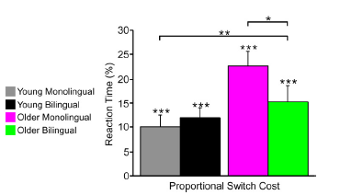
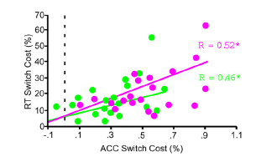
Increased task switching costs with age but
older bilinguals fare better than older
monolinguals. For young adults, the
effect of bilingualism is not as dramatic.
Relationship between neural and behavioral switch
costs in older adults. This graph shows an age by
group interaction for the ACC, the same region
identified in other studies as associated with more
efficient conflict resolution for bilinguals.

Slide 22
How does the mental juggling of two languages create
these advantages/changes?
The evidence to date is largely correlational. Bilinguals are often
advantaged relative to monolinguals on measures of attentional
control and executive function.
But what aspect of language use is responsible for these consequences
to cognition? Bilinguals use language in many different ways.
They read and listen to ambiguous words in both languages.
They select words to speak.
They code switch from one language to the other.
They resolve syntactic ambiguities within and across languages.
They engage in dialogue with speakers who vary in whether they are
monolingual or bilingual.

Slide 23
Each aspect of language processing may impose different cognitive demands that then create distinct profiles of bilingual cognition. Different forms of bilingualism may have the consequence of differentially tuning the neural networks that support language use (e.g., Green & Abutalebi, 2013). Some bilinguals code switch frequently and others not at all. Some languages share similar form and others to do not. But in all cases, bilinguals have to potentially negotiate a higher level of competition in their everyday use of language than monolinguals. For them, mental life is truly a jungle!

Slide 24
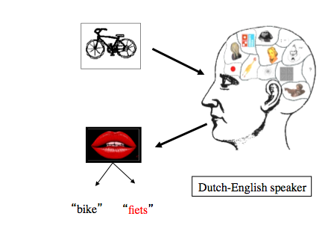
But some argue that speaking is the critical language processing task. When you speak two languages you must choose between them before you utter a single word and it is that selection mechanism that has been hypothesized that appears most closely related to the observed cognitive consequences of bilingualism.

Slide 25
In the time that I have remaining today, I want to illustrate a
program of research on bilingual speech planning that exploits
the power of convergence across different language science
methods. The goal is to focus on the mechanisms engaged during speech planning and then to attempt to relate them to the documented consequences of bilingualism.

Slide 26
How is cross-language competition in speech planning resolved?
Two general alternatives:
Bilinguals develop skill in selectively attending
to the critical information that signals language status.
Bilinguals learn to inhibit irrelevant information once
it has been activated.
Either of these mechanisms might confer positive cognitive
consequences.
Speech production may be the critical juggling skill because only
in speaking is there a requirement to select a single alternative
among activated candidates.

Slide 27
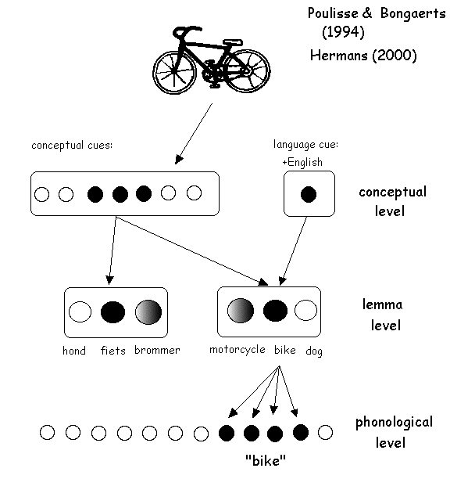
Bilingual speech planning:
Can bilinguals can effectively attend to cues in the language context to direct their attention to the intended language?
Mental
Firewall

Slide 28
Research strategy:
Look for the cues that enable language selection
Look more directly for evidence of attenuation or
inhibition of the language not in use

Slide 29
But cues to language status are not easily exploited.*
Both languages are active regardless of the similarity
of the bilinguals two languages.
Different-script bilinguals (e.g., Japanese-English)
Different-modality bilinguals (e.g., ASL-English)
When bilinguals encounter language ambiguous words in sentence context, both senses of the word are activated. The language of a sentence does not, itself, restrict activation to one language alone.
So the research strategy has been to look more directly at the
mechanisms that may enable language selection.
* But see Zhang et al. (2013; PNAS) for recent evidence of cue sensitivity!

Slide 30
The results of behavioral studies of lexical production suggest
That both languages are active during speech planning of a single
word utterance in L2 even when the speakers are highly
proficient in the L2. L1 may have to be inhibited to allow
L2 production to proceed.
The modulation of the native language may be a critical feature
of multiple language use that differentiates bilinguals from
monolinguals and that creates consequences for both language
processing and cognition.
Bilinguals who are highly dominant in their native language may
sometimes be slower to speak the L1 than the L2 if they have just
spoken the L2. L1 loses its privilege!

Slide 31
Past behavioral studies of language mixing in speech production have
reported asymmetries with greater apparent processing costs to the L1
suggesting inhibition of the L1
Language Switching:
Meuter & Allport (1999)
Language Mixing:
Kroll et al. (2000)
In both switching and mixing there is a differential cost to L1

Slide 32
Converging measures of cross-language activity when
proficient bilinguals plan to speak in L1 or L2
fMRI
Requires collaboration between psychologists, linguists, and
cognitive neuroscientists.

Slide 33
Misra, Guo, Bobb, & Kroll (2012)
Use ERPs to examine the time course of cross-language activation in bilingual speech planning.
The effect of language blocking in picture naming in the L1 and L2.
Relatively proficient Chinese-English bilinguals but dominant in L1 Chinese.
Group 1: Name pictures in L1 then L2
Group 2: Name pictures in L2 then L1
The pictures were the same for both languages; two blocks per language: L1, L1, L2, L2 or L2, L2, L1, L1
Name in
L1
Name in
L2
Name in
L2
Name in
L1

Slide 34
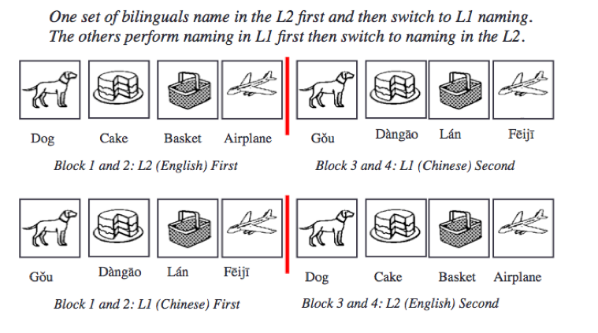
Misra et al. (2012):

Slide 35
Blocked Picture Naming: Early indices of inhibition
L1 L2
L1 First
L1 Following L2
L2 First
L2 Following L1
Inhibitory pattern for L1 and facilitatory pattern for L2:
If it were a matter of recovering from momentary inhibition following naming in L2, then later in the L1 naming blocks we should see this recovery but the pattern persists, suggesting the presence of global inhibition.

Slide 36
Converging measures of cross-language activity when
proficient bilinguals plan to speak in L1 or L2
fMRI
?

Slide 37
Gerfen et al. (in preparation): Effects of language blocking on articulatory duration: Are there late inhibitory effects?
Name pictures in three blocks: L1 Chinese- L2 English- L1 Chinese
Name L1 Name L2 Name L1
Articulatory duration is longer in L1 following picture naming in L2.
These data are similar to the conditions that produced extended negativity in the ERPs. The effect is present even for identical tokens that should produce repetition priming, suggesting that there is inhibition of the L1 following naming in the L2.

Slide 38
Converging measures of cross-language activity when
proficient bilinguals plan to speak in L1 or L2
fMRI
?

Slide 39
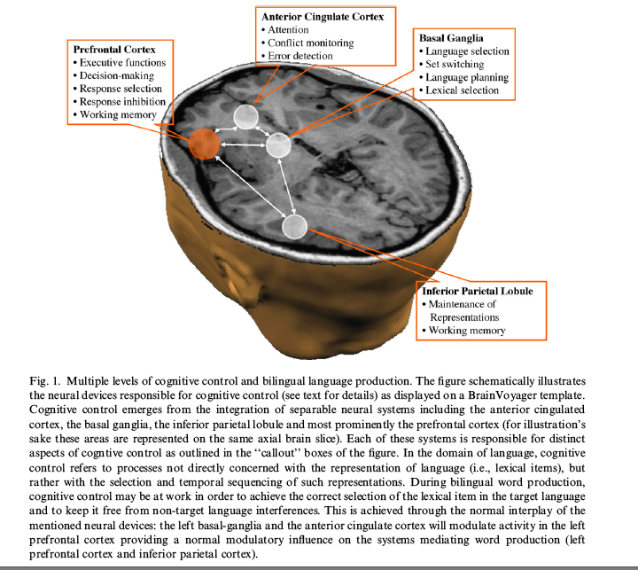
Is there supporting fMRI evidence? Abutalebi & Green (2007)

Slide 40
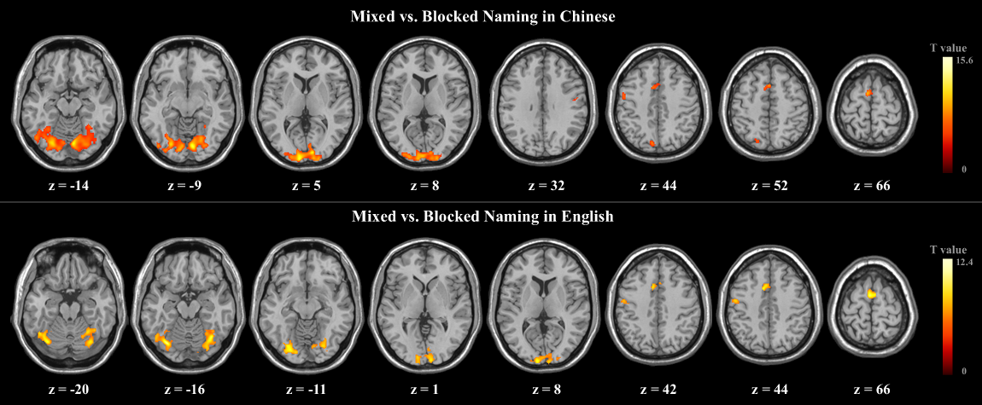
Guo, Liu, Misra, & Kroll (2011): fMRI evidence for global inhibition
Chinese-English bilinguals named pictures in three blocks:
Chinese (L1) – English (L2) – Mixed
English (L2) – Chinese (L1) – Mixed
The comparison between blocked and mixed picture naming performance was defined as local switching, while the comparison between blocked naming in each language was defined as global switching.
Distinct patterns of neural activation were found for each of these comparisons.
Name in
L1
Name in
L2
Name in L1 or L2
Name in
L2
Name in
L1
Name in L1 or L2

Slide 41
Guo, Liu, Misra, & Kroll (2011): fMRI evidence
Distinct patterns of neural activation were found for local inhibition as compared to global inhibition in bilingual word production:
The dorsal anterior cingulate cortex (ACC) and the supplementary motor area (SMA) appear to play important roles in local inhibition, while the dorsal left frontal gyrus and parietal cortex appear to be important for global inhibition.

Slide 42
Many questions remain.
What is inhibited? And how long is it inhibited?
What becomes inhibited?
peach (a single word)
fruit (a semantic category)
all of the native language
What are the consequences of inhibitory processes
in language processing for domain general cognition?

Slide 43
Does inhibition of L1 depend on the context of language use?
Linck, Kroll, & Sunderman (2009): Losing access to
the native language while immersed in a second language
Examined the performance of L2 learners who were all native
English speakers at an intermediate level of studying Spanish
as the L2.
One group was studying abroad in Spain and immersed in the
L2 environment whereas the other group was studying in the
classroom in very monolingual Pennsylvania.
L1 activity was reduced in both comprehension and production
when learners were immersed in the L2 environment.

Slide 44
Linck et al. (2009): Semantic fluency in immersed learners vs.
classroom learners
The immersed learners had lower semantic fluency in English, the L1. Taken together with their performance on a translation recognition task showing that they were insensitive to lexical distractors in the L1, these data suggest that they were suppressing the L1 while living in the L2 context (and see Baus et al., 2013, for related findings).

Slide 45
Summary of studies on bilingual speech planning
When relatively proficient bilinguals prepare to speak words in their L2, there is inhibition that appears to suppress the activity of the stronger L1.
The inhibition seen for the L1 can be seen in the earliest measures of speech planning evident in ERPs, in performance on behavioral tasks, in late acoustic measures of produced speech, and in differential patterns of brain activity in fMRI studies.
A similar inhibitory pattern of L1 is seen among immersed L2 learners.
Understanding the short and long-term consequences of these changes will be critical for developing a comprehensive account of what it means to be a proficient bilingual but also for what it means to lose access to the native language following extended L2 immersion in healthy adults or for bilingual aphasic patients for whom cognitive control is crucial.
A critical issue is now to understand how the observed inhibition relates to the presence of bilingual advantages in the realm of executive control. Inhibitory control may involve different brain networks that are engaged in specific ways to solve different types of language processing problems.

Slide 46
The native language is not the Rock of Gibraltar
These studies of cross-language interaction suggest that not only does
the L1 influence the L2, but the L2 has persistent effects on the L1,
even for highly proficient bilinguals. Negotiating these influences
has been hypothesized to confer some of the observed consequences to
cognition in the realm of executive function.
The effects of bilingualism on the L1 are not just about words. We see
related phenomena at every level of language processing, including
the grammar.

Slide 47
Is this story about the effects of cross-language activation from L2 to L1
only about the lexicon? No. It’s also about the grammar.
Many studies of the L2 grammar demonstrate persistent transfer of the L1 in using the
L2 but they also show that the L1 becomes sensitive to the influence of the L2.
Dussias (2003): How do the structural commitments of one language influence
the processing of the other language?
Peter fell in love with the daughter of the psychologist who studied in California.
Who studied in California?
Native English speakers: the psychologist
Native Spanish speakers: the daughter
Critical result: Native Spanish speakers immersed in an English dominant
environment begin to parse sentences in Spanish, their native language, like
English, their L2!

Slide 48
There are many other questions to ask.

Slide 49
Does multilingualism enhance the protection from Alzheimer’s
type symptoms that have been reported for bilinguals?
The evidence is mixed.
Bialystok, Craik, & Freedman (2007): Compared hospital records
of monolingual and bilingual dementia patients: Monolingual patients
were, on average, almost four years younger than bilingual patients at
time they were diagnosed.
Gollan et al. (2011): Replicated the bilingual advantage in providing
protection against the onset of Alzheimer’s type symptoms but only
for those bilinguals with lower levels of education.
It looks like it depends on how the languages have been used.

Slide 50
Our review of the recent psycholinguistic and neurocognitive evidence
on juggling more than one language in the same mind and brain suggests
that life experience in using more than one language has profound
consequences for both language processing and domain-general aspects of
cognitive function and cognitive control
There is not a simple answer to the question of whether more is better; it
appears to depend on a set of factors that also determine the way in which
cognitive control is manifest in bilinguals, including the context and age
of acquisition, proficiency and language dominance, and the structural
properties across the languages.
Other recent research suggests that early learning mechanisms are affected
by language use (see, e.g., Petitto et al., 2012, on the Perceptual Wedge
Hypothesis) and ultimately it may be those learning mechanisms and the
plasticity associated with them that are responsible for some of the
consequences we have described.

Slide 52
We would know none of this if we studied monolinguals
only. The implications are not just for our interest
and curiosity – they require a revision of the
traditional story about language development and about
the plasticity associated with adult learning.
But still – there are some adults who are simply not
that flexible… and perhaps for them, it is indeed too late to start!

Slide 53
An American in Paris – no lexicon; no grammar, and
absolutely no inhibitory control!
Thank you!

