Slide 1
Intonation: From animal communication to grammatical encoding
Brechtje Post *, Emmanuel Stamatakis⁺ Iwo Bohr*,
Francis Nolan*, and Chris Cummins *
*DTAL Phonetics Laboratory ⁺Division of Anaesthesia

Slide 2
Intonation has mutliple functions
Intonation – the melody of speech – plays a central role in human communication:
it can provide immediate cues to the start of new words or phrases in the speech stream and to the meaning of utterances
wrong intonation often leads to communication breakdown.
However, intonation is difficult to analyse, because it signals multiple functions simultaneously:
Neutral declarative Excited/surprised declarative
Paralinguistic use of intonation: signalling attitude or emotion
Linguistic use of intonation: signalling informational content of message

Slide 3
Form x meaning in intonation

Slide 4
Issue: Form and meaning closely intertwined
Functional categories and gradient variation are closely intertwined
We know very little about how acoustic cues interact in signalling different ‘types’ of meaning
Both can be used to signal linguistic as well as paralinguistic variation in meaning (e.g. Crystal 1969, Bolinger 1970, cf. Taylor 1995)
Gradient variation in form can be categorically meaningful
Categorical variation in form can signal paralinguistic meaning

Slide 5
Intonation and animal communication?
Dual function rooted in biological imperatives (Gussenhoven 2002):
Universality in paralinguistic use of intonational cues, e.g. Frequency Code (Ohala 1983):
Biologically determined condition: Variation of size of larynx ~ F0, and variation of size of larynx ~ overall body size:
Lower F0 with larger larynxes, and higher F0 with smaller larynxes
F0 exploited for the expression of power relations
Linguistic uses of intonation (informational rather than affective or attitudinal) can be grammaticalised uses of these ‘universal’ form-meaning relations.
Encoding becomes discrete, language-specific, and form-meaning relation may be arbitrary

Slide 6
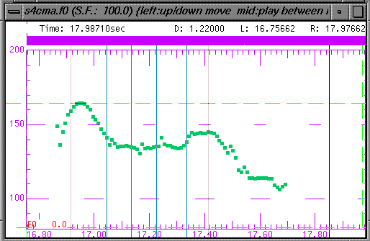
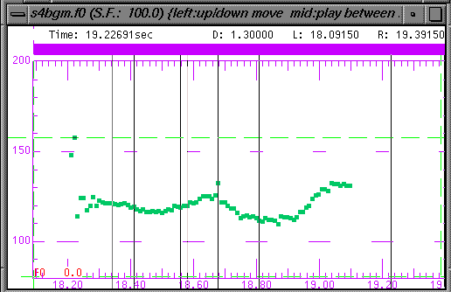
Linguistically encoded form-function
Most common tune in statements:
falling in Cambridge English, but
rising in Belfast English
Different forms for same meaning
Cambridge English Belfast English
on the railings
on the railings
relations are language-specific, arbitrary and discrete
(Jarman & Cruttenden 1976, Rahilly 1991, Grabe and Post 2004)

Slide 7
Form-function in intonation: Theorising
Development theories form-function relation in intonation:
requires better understanding of dependencies in fine phonetic detail of intonational cues
which signal separable but intertwined components in intonational meaning (Gussenhoven 2002):
linguistically structured part: relations are language-specific, arbitrary and discrete
iconic part: relations largely independent of individual language (universal) – based on biological codes
(= ‘linguistic’ vs. ‘paralinguistic’ meaning)
(Post et al. 2007)
Notes:
What WE would like to argue, on the basis of these points is that
Further development theories form-function relations in intonation
will greatly benefit from better understanding of the kinds of parameters involved FPD dependencies
Which, we believe, signal two separable but intertwined components in intonational meaning: a linguistically structured part in which the form-function relations are in principle language-specific, arbitrary and discrete, and a part which is iconic and largely independent of the individual language, which I will refer to here as linguistic and paralinguistic meaning.

Slide 8
Research questions
Can we provide independent behavioural and neurobiological evidence to back up linguistic hypotheses about linguistic and paralinguistic uses of intonation?
In doing so, can we provide a more refined, linguistically informed model of the neurobiological underpinnings of intonation?
ESRC-funded project (RES-061-25-0347): Categories and gradience in intonation:
Evidence from linguistics and neurobiology (PI Post, CI Stamatakis)

Slide 9
Production, perception fMRI experiments: Goals
Production and perception experiments to explore utterance-final rises and falls in ‘standard’ British English to obtain
independent behavioural evidence, and
a better understanding of the phonetic detail of the cues involved (duration, loudness, spectral tilt, and their interaction with pitch)
which will also inform stimulus development in the fMRI studies
fMRI to provide neurobiological evidence
Follow-up: EEG to explore time-course of processing (with Kai Alter, University of Newcastle)

Slide 10
Production experiment
Rises and falls elicited in context
controlled for stress and segmental make-up
(e.g. MUlana – naMUla – lanaMU)
eliciting different linguistic and paralinguistic functions:
declarative, interrogative, listing
neutral vs excited
9 male speakers, 5 repetitions in minimally different contexts
To investigate cues and their dependencies:
Acoustic measurements of duration, intensity, and F0
(Post, Schmidt, Hudson, Nolan, and Stamatakis, forthcoming a)

Slide 11
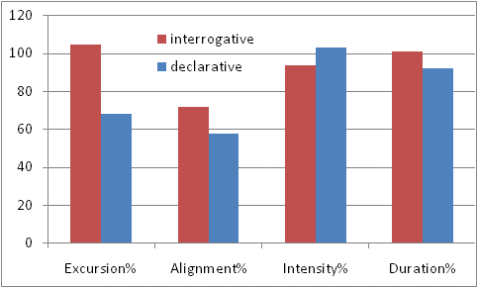
Production: Linguistic function
(all at p<0.001)
However: Confound with difference in form
Which (if any) measures differ when the same pitch accent is used?
(Post, Schmidt, Hudson, Nolan, and Stamatakis, forthcoming a)
Notes:
in the nucleus compared with the prenuclear syllable and the final syllable (all normalised as % here)

Slide 12
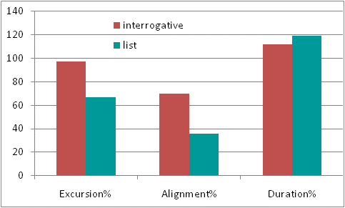
Production: Linguistic function – rises only
Effects on F0 are the same
Differences associated with declarative vs interrogative contrast also apply to list vs interrogative
(Post, Schmidt, Hudson, Nolan, and Stamatakis, forthcoming a)

Slide 13
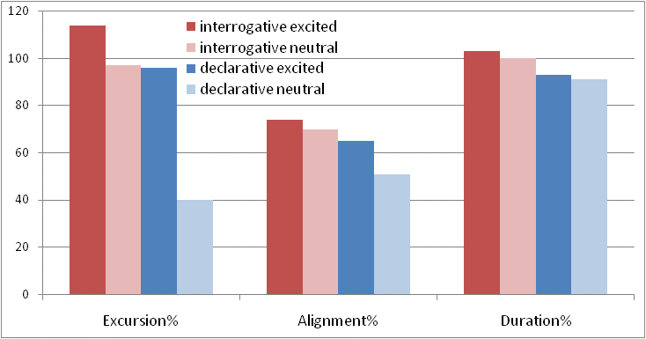
Production: Effects of excitement constant
Is this reflected in perception?
Effects of function (p<0.001), but effect of excitement is additional to effect of linguistic function

Slide 14
Perception experiment
Question:
Is linguistic function perceived more categorically than paralinguistic, all else being equal?
Identification task:
4 x 3 ST steps for 24 tokes (resynthesis) 3ST
2 conditions:
Linguistic (Does this sound like a statement?)
Paralinguistic (Does this sound excited?)
Dependents: identification judgement & reaction time
nucleus
(Post, Schmidt, Hudson, Nolan, and Stamatakis, forthcoming a)
Notes:
3 bases: “linguistic”, “paralinguistic”, hum

Slide 15
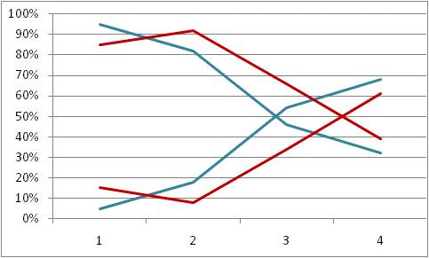
Perception: Linguistic vs paralinguistic function
1420ms.
1400ms.
Significant effects in identification data:
Function, step
Function x step: identification differences in steepness
1380ms.
1360ms.
1340ms.
1320ms.
1300ms.
1280ms.
paralinguistic
linguistic
1260ms.
1240ms.
1220ms.
RT:
Function : Linguistic identification is faster; Step: all identification slower at cross-over and for steps 3 and 4.

Slide 16
Findings so far
Perception and production determined by function
where linguistic function stronger identification effects & faster responses than paralinguistic function (with contrast tested here)
and linguistic function is perceived significantly more categorically than paralinguistic function
They appear to be distinct
Neurobiological evidence to support behavioural findings?
(Post, Schmidt, Hudson, Nolan, and Stamatakis, forthcoming a)

Slide 17
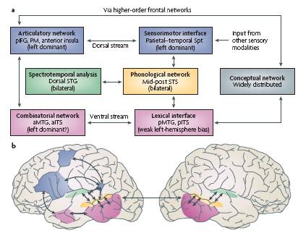
Dual-stream model of functional anatomy of language
Two distinct, functionally specialised parallel processing streams:
Dorsal stream
Ventral stream
Speech processing: multiple streams involving anatomically separable areas which are connected through multiple pathways
Interactions with the dorsal-stream network for abstraction and categorisation in speech (Davis and Johnsrude 2007)
(Hickok and Poeppel 2007)
Notes:
Two distinct, functionally specialised parallel processing streams can be distinguished within this network: a dorsal and a ventral stream (Hickok and Poeppel 2000, Scott and Johnsrude 2003). Recent fMRI evidence suggests that interactions with the dorsal-stream network ensure that speech is perceived categorically: successive stages of processing achieve greater abstraction from the acoustic input while maintaining multiple possible interpretations of the incoming signal, with higher-order frontal regions modulating activity in lower-order temporal regions (Davis and Johnsrude 2007).

Slide 18
Abstraction and categorisation for speech
Differential processing, involving structures in Superior Temporal Gyrus and Left Inferior Frontal Gyrus, shown for abstract (morpho)phonological processing (e.g. Burton et al 2000, Obleser et al 2004, Eulitz and Lahiri 2005, Tyler et al 2005, Gandour et al 2003a,b,c, 2004)
Can this also be the case for intonational information?

Slide 19
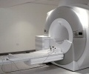
fMRi hypothesis
The same variation in form elicits different patterns of neural activation depending on the function of the intonation contour
linguistic intonation predominantly activates a network including areas observed for other ‘phonological’ processing (LIFG, STG/MTG)
paralinguistic intonation is more strongly right lateralised (e.g. Schirmer et al. 2006 for review)
fMRI experiment

Slide 20
Design and stimuli
Forced-choice response identification task with
Two function conditions:
Linguistic (Does this sound like a statement?)
Paralinguistic (Does this sound excited?)
Two form conditions:
Rising (3 steps)
Falling (1 step)
24 items as before
Hum functioning s baseline: to isolate speech-specific activation
15 subjects (mean age=23), Southern British English, right-handed
Rise +9ST
Rise +6ST
Rise +3ST
100 Hz
nuclear accent
Fall - 3 ST
(Post, Stamatakis, Bohr, Nolan, and Cummins 2013)

Slide 21
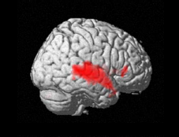
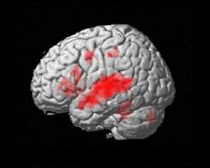
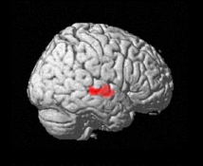
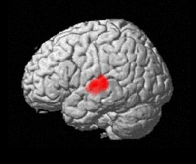
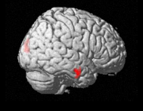
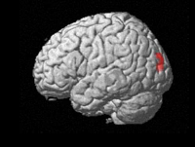
Speech-specific activation by function
linguistic function
paralinguistic function
L inferior frontal areas, including Broca’s area, implicated in processing certain syntactic, segmental, morphological and tonal processing
(e.g. Post et al. 2009)
speech > hum
speech > hum
Right
Left
Right
Left
Hemodynamic response for SPEECH
(subtraction analysis; p<0.001 at voxel level, FWE corrected at p<0.05 cluster level)
Activations for speech stimuli in the linguistic and paralinguistic conditions in MTG/STG bilaterally (as expected), but
more activation in linguistic condition overall, with posterior areas in STG and some activation in LIFG (as expected),
L cerebellum, implicated in processing prosody and words
(e.g. Binder et al. 2009)
Auditory temporal areas bilaterally, including areas implicated in phonological processing
(e.g. Hickock and Poeppel 2000)
direct contrast between the two confirms differential processing
But effect not very strong: interaction form and function?
linguistic vs. paralinguistic function
Right
Left

Slide 22
Conclusions: Animal communication vs. Grammatical encoding
Intonational processing is supported by distributed cortical network which is differentially activated depending on function
where function interacts with intonation contour
involving, for linguistic information, structures implicated more generally in processing abstract categorical ‘phonological’ information
Intonation has a dual function which is supported by distinct cognitive and neural mechanisms
the one being encoded in the linguistic system
the other reflecting biological imperatives much more directly.
(Post, Schmidt, Hudson, Nolan, and Stamatakis, forthcoming a)

Slide 23
Question
Evidence for processing of linguistic intonational information is clear-cut
But direct comparison between linguistic and paralinguistic condition less clear, and effects in paralinguistic are weak
obscured by interactions and/or time course differences in overlapping neural systems?
ERP

Slide 24
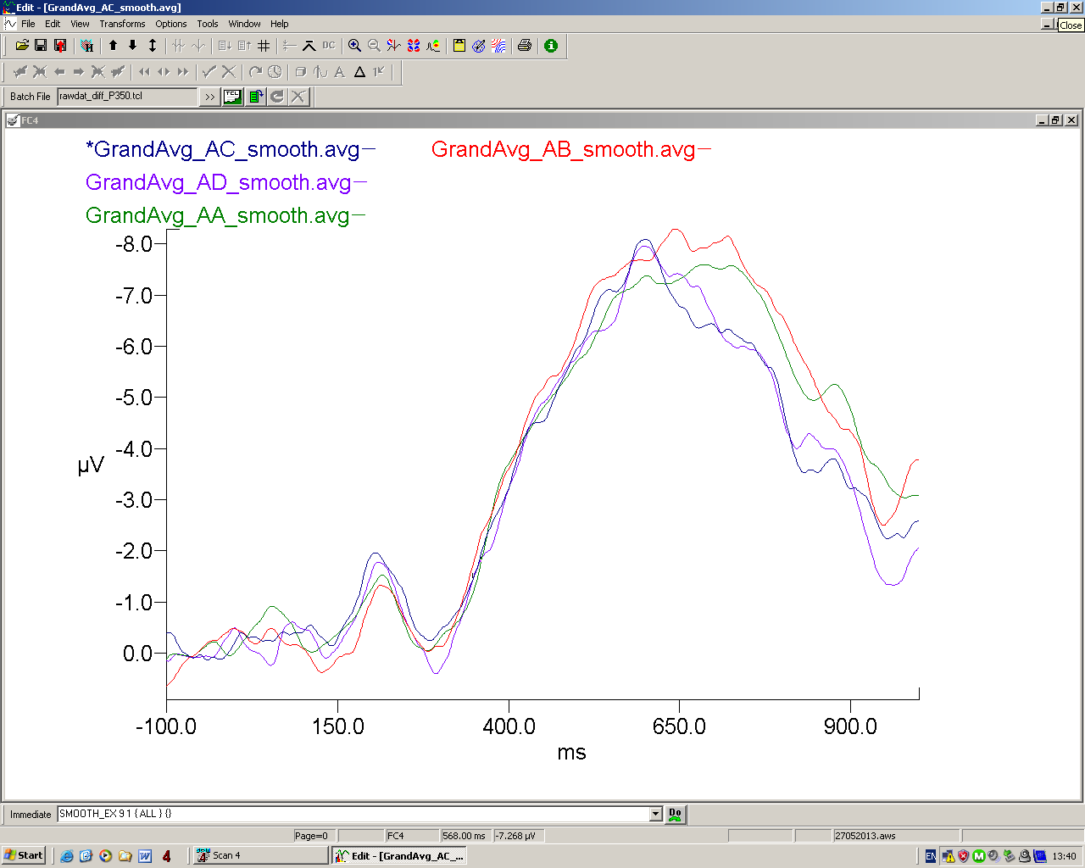
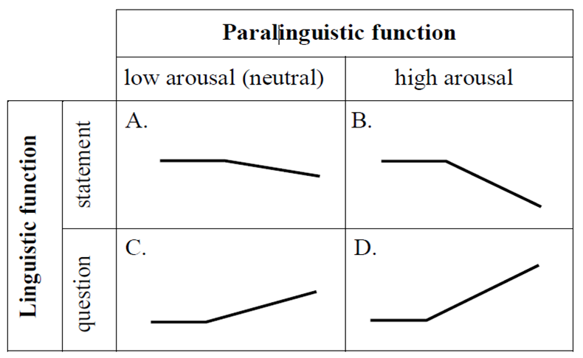
ERP: Preliminary results
Comparison of smoothed grand average waveforms illustrating significant differences, showing effects for linguistic function
Neutral statement
Excited statement
Neutral question
Excited question
N400?
Late Positivity: question vs statement
N1 ?: reflecting recruitment of auditory centres
P2?
P58 (fronto-parietal): question vs statement
Notes:
Compares smoothed grand averages for the baseline condition (in green) and the three deviants (list colours) measured at FC4. These illustrate the significant differences that we found; the analysis was an analysis of variance comparing the averages of the difference waveforms (i.e. Deviant – baseline). We haven’t had time to properly interpret these data yet, but what we can see is that (click 1) there is the expected positivity associated with the recruitment of auditory centres; they characterise the auditory ERP paradigm. We can also see [click2] a positivity. We provisionally assume that what we see here is that the expected N1-P2 complex is delayed, with N1 peaking around 200ms and P2 around 350. carrying out analysis with different basline time window to verify whether this can be a baseline problem, since all ERP components appear to be delayed. P2 has been associated with pitch mismatch and linguistic mismatch in previous experiments, not clear yet how to interpret it in the context of our experiment, but overall activation was significantly stronger here for the question conditions than for the statement (not visible here). We also observed what may be a delayed N400, with more negativity for excited questions than for the other conditions. N400 has been associated with lexical tone, but we’ll need to think about this. Finally [click 4], we observed a set of clear positivities: P58 in fronto-parietal areas, and late positivity, both showing higher peaks for questions than statements. So these preliminary results at least appear to confirm that differences in intonational function are also reflected in the timecourse of processing.
During testing, participants stared at a fixation cross on a computer screen while pairs of stimuli were presented: a baseline stimulus (A) followed by either another baseline stimulus (A) or one of the deviant stimuli B, C or D. The participant was told to pay attention to the pairs of stimuli and detect any difference in pitch contour between the stimuli within each pair. Following 20% of the stimulus pairs, the participant was asked by a computer screen to respond by pressing a key, to indicate whether the stimuli within the pair were the same or different in pitch contour. These 20% of trials were discarded to prevent any electrical potentials corresponding to voluntary movement from interfering with the ERPs of interest. Participants were instructed not to respond on the 80% of trials for which a response was not requested.
Pre-processing of the data was carried out using Compumedics Scan4 Edit software. The raw data were downsampled from 1000 to 500 Hz using a decimation filter. A low pass filter of 30Hz with 6 db/octave was applied. Epochs were made from -100 to 1000 ms time-locked to the beginning of the second word in each pair

Slide 25
With thanks to
the radiographers and other staff at the MRC Cognition and Brain Sciences Unit for their support with data collection
Toby Hudson, Hae-Sung Jeon, and Elaine Schmidt for their assistance with data collection and analysis
Kai Alter, Catriona Cummin, and Zee Yong Ng for making the ERP experiment possible

Slide 27
ERP methods
22 participants
The stimuli were resynthesised from a set of 22 base stimuli (all trisyllabic; 8 with initial stress,14 penultimate stress),. For each base stimulus, 4 resynthesised versions were generated, varying F0 in 4 steps:(A) fall of 3 ST, and (B) fall of 9 ST (C) rise of 3 ST (D) rise of 9 ST. Stimuli are between 1 and 1.2 seconds long.
Discrimination task (same/different judgement)
The EEG consisted of 30 cap-mounted Ag/AgCl electrodes, placed according to the standard 10-20 system, with two mastoid electrodes. The left mastoid was used as an online reference. A SynAmps amplifier and Compumedics Scan 4 Acquire software were used to record the EEG at a sampling rate of 1kHz. Data analysed using Compumedics Scan4 Edit software, downsampled to 500Hz and low-pass fileterd. Epochs made from -100 to 1000 ms time-locked to onset second word.Students T on grand averages followed by anova on difference waveforms

Slide 28
Procedure
Forced-choice timed response task
Event-related design, 2 sessions of 300 events each: - 60 null events - 120 speech stimuli - 120 ‘hum’ stimuli
y
n
silence
(0.5 s)
stimulus
(0.4-0.6 s)
response
(~1.3s)
one event (~2.3s)
Figure $1.
Essential information about features of stimuli and timing of their presentation. A: Schematic illustration of five F0 contours as produced for each, in a red boxes steps modelled in parametric design (with linear parametric modulators assigned) B: timing of a non-null event component, and questions to answer in response to non-null stimuli

Slide 29
Hypotheses
intonation is best analysed in terms of distinct phonological and phonetic levels of representation, which are defined by their contribution to meaning (‘linguistic’ and ‘paralinguistic’), and can be realised through gradient as well as categorical variation in form
the neurobiological processing of intonation is hierarchically organized, reflecting these functional and formal distinctions.

Slide 30
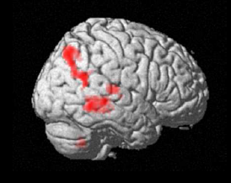
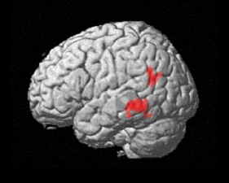
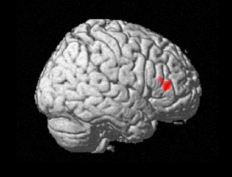
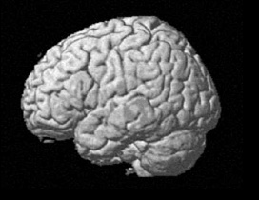
Pitch as parametric modulator
linguistic function
Control for possible interaction:
Analysis with variation in pitch height as parametric modulator
Shows activation when variation in the height of a rise is factored out
Linguistic condition shows network of activations consistent with higher-level processing of phonological and intonational information
Including bilateral temporal (esp. MTG), R parietal (e.g. Doherty et al. 2004)
Paralinguistic processing restricted to RIFG, often implicated in processing of emotional prosody
(cf. Schirmer and Kotz 2006)
paralinguistic function
+9st
+6st
+3st
100 Hz

Slide 31
Research question
Most neurobiological studies of intonation have ignored the distinction between linguistic and paralinguistic uses of intonation
testing the one without controlling for the other (cf. Wildgruber et al. 2004)
Potential confound between the two
Widely diverging conclusions about the neural substrates of intonation (cf. Mayer et al. 2002)
Here, we try to disentangle the two by varying the function, but keeping the form constant

