Slide 1

Multilingual planet – learners of multiple languages: challenges for the researcher
Henriette Hendriks
University of Cambridge, DTAL

Slide 2
Early Assumptions
Those who learn languages in a natural (non-guided) way are children.
Most children learn one language only, the language spoken by their parents and the environment.
Second languages are learnt as foreign languages, in taught (guided) contexts only, by children of a certain age (from 10-12 onwards) and adults (at University).
Occasionally, children may receive input from two languages simultaneously, but that is an exception to the rule.
All these assumptions are related to fact that most researchers Europeans and Americans, living in an exclusively monolingual environment

Slide 3

History of Language Acquisition Studies
From the start of the twentieth Century:
  Child language acquisition studies only:
    diary studies (Stern and Stern, Leopold data)
    Large datasets (Templin, 1957)
    In-depth longitudinal studies (Brown, 1973; Clark 1973; de Villiers and de Villiers, 1973)
From the 1960s (with increase of immigration in Europe):
  Adult Second Language Acquisition Studies (non-guided)
    ZISA Project (Heidelberg) Meisel et al.
    “ESF” Project, Adult Immigrant Second Language Acquisition (Klein and Perdue)
From the 1990s (with increase of Spanish speakers in USA):
  Foreign Language Acquisition Studies. Mostly cross-sectional, and classroom based.

Slide 4
The Facts
Multilingual speakers outnumber monolingual speakers in the world's population (Tucker, 1990).
Many speakers have been multilingual, and countries around the world present an impressive mix of languages spoken:
  isiZulu, Afrikaans, Sesotho sa Leboa, English, isiXhosa, Sesotho, Xitsonga, Setswana, siSwati, Tshivenda, European languages, Oriental languages, Other (South Africa).
Languages spoken in the UK (but only few multilingual speakers!):
  English, Welsh, Scottish Gaelic, Lowland Scots, Cornish, Irish, BSL, Polish, Punjabi, Urdu, Bengali, Gujarati, Arabic, French, Greek, Italian, Tamil,…
More than two billion people will be learning English by 2020 at all ages ranging from 6 months (!) to 96 years.

Slide 5
Some Major Questions in Lang Acquisition
Existence / Use of Language Acquisition Device
Critical Period or Not
Influence of typology on L1 and L2
Relationship between Language and Thought
Organisation of languages in the Brain
No definitive answers yet …

Slide 6
Some examples of questions used as Research Vehicle
In what order are morphemes acquired? (Innate system vs. Input dependent)
The acquisition of the expression of tense and aspect (Cognitive development vs. linguistic development)
How do learners acquire the expression of motion events? (Relation language and thought / influence of typological differences acquisition / age of acquisition)
The acquisition of a third language (Influence of earlier languages)

Slide 7
Morpheme Order Studies
Hypothesis guiding study: if learners do not learn language as a reaction to the input only (anti-behaviorist) they will acquire morphemes in a fixed order irrespective of input phenomena, as they use developmental strategies instead.
Results: The main morphemes in the English Language are acquired in a predictable order by all children acquiring English as a first language, as a second language (with different amounts and types of input) and by adults learning English as a second language (different first languages, different ages, different amounts of input).
Outcome with respect to major questions: Results confirm predictions, BUT unsatisfactory in terms of explanations of specific order found (syntactic complexity, semantic complexity, phonological complexity, perceptual saliency, Slobin’s operating principles).
  Larsen-Freeman in 1975, concluded very unsatisfactory and surprisingly that frequency of occurrence in the input is really the only remotely reliable explanation.

Slide 8
Morpheme Order Studies
BUT
“The present study investigated whether the accuracy order of L2 English grammatical morphemes differs across L1 groups. The clustering approach adopted in the study demonstrated clear influence of L1 on the accuracy order with respect to all the target morphemes. […] the accuracy rank of articles prominently differs between the groups whose L1s have articles (Spanish, German, and French) and those whose L1s do not (Japanese, Korean, Russian, and Turkish […] the present empirical analysis den[ies] the notion of the universal L2 acquisition order of English grammatical morphemes.” Murakami, 2011.
No definitive answer yet …

Slide 9
Defective tense or Aspect Hypothesis?
Early studies (Antinucci and Miller) showed that children before the age of four use tense markers to reinforce lexical aspect rather than mark tense.
Original hypothesis: Children do not have an understanding of time proper / tense, and therefore do not mark it appropriately in language (cf. Piaget for children’s understanding of tense).
Iff this is the case → adult second language learners will use tense markers appropriately
Studies by Shirai and Andersen, Bardovi-Harlig and others showed: Adult L2 learners also use tense markers to reinforce lexical aspect in the first instance.
Conclusion: Cognitive development does not cause the pattern in children.
What causes the effect? Is there a distributional bias?

Slide 10
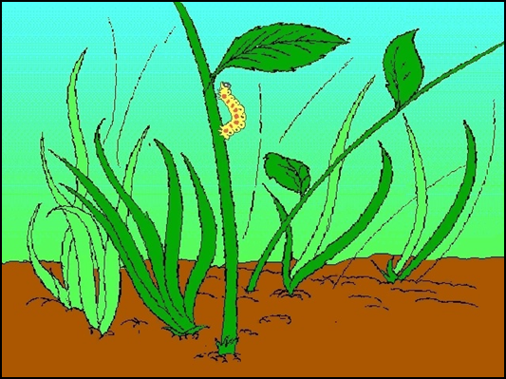
The expression of motion events
Typological differences in the way in which motion events are expressed (Talmy 2000):
  Motion situation involves a Figure (object to be located) and a Ground (object with respect to which Figure is located), Motion per se and the Path of Motion, i.e., the expression of the relational link between Figure and Ground.
  Satellite-framed languages express the core part of the motion event (Path) in the satellite
  Verb-framed languages express the Path in the verb
  The boy skidded across the river
  Le garçon traversait la rivière en glissant

Slide 11
The Expression of Motion Events:
Questions for Acquisition
L1: Are typological differences visible from early age onwards, or do children start out with more general way of expressing motion?
L2: According to Slobin’s thinking for speaking hypothesis, the lexicalization patterns resulting from the typological differences should be firmly entrenched by adulthood which may cause problems in second language acquisition. Is this something we find in L2 acquisition?
2L1: Bilingual children are learning two languages at the same time, and should therefore acquire both modes of thinking for speaking simultaneously. Do they?
Child L2 acquisition: At what age do the patterns become entrenched and start interfering with the acquisition of the L2?

Slide 12
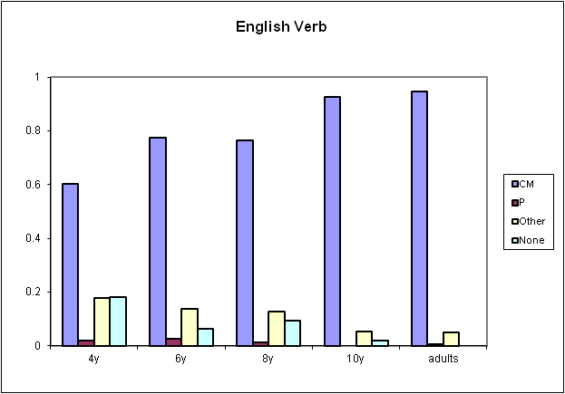
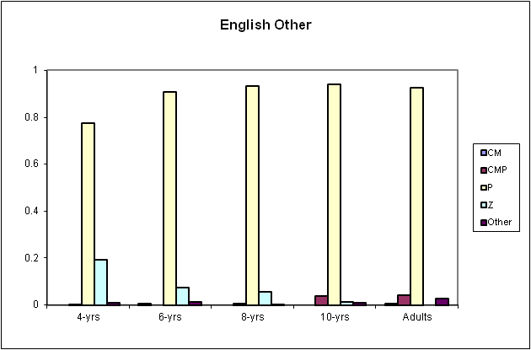
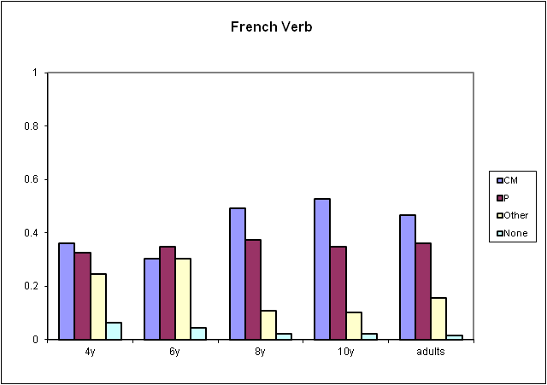
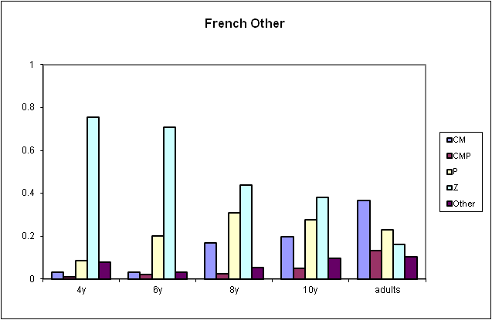
Motion Expressions L1
English Path in Satellites systematically, French Path in verb or other

Slide 13
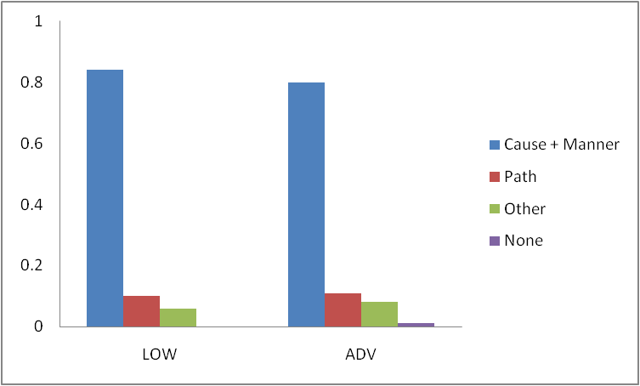
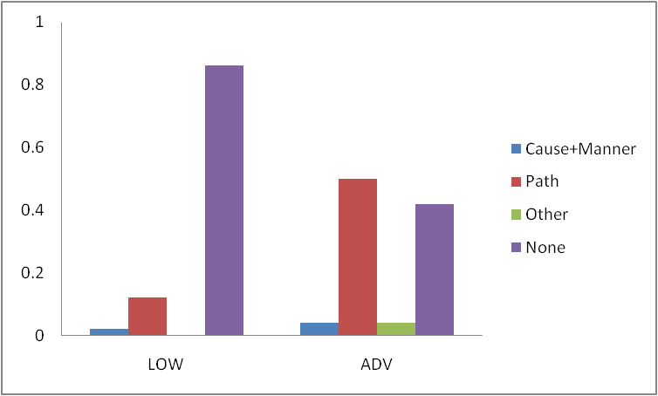
Motion Expressions Adult L2
L2 learners still look like English speakers, as far as information in verb is concerned. Development over time from only expressing Cause and Manner in verb and no Path, or Path in separate sentence / Idiosyncratic Path expressions; Cause, Manner and Path expressed in complex clauses, BUT information structure still as in English.

Slide 14
Motion Expressions simultaneous bilinguals and L2 learners (Engemann, 2012, 2013)
Child L2 learners show similar phenomenon in terms of information organisation, even if entrenchment has had very little time to set in.
Bilingual children (one parent, one language from birth) show similar phenomenon in terms of information organisation, even though formally they are entirely like native speakers of French of their age.
  Le garçon pousse la voiture en montant (FR: monte en poussant)
  The boy pushed the car (while) going up
Note that other studies do show that simultaneous bilinguals look like monolinguals, and that younger children have better chances of achieving native like productions.
Age of Acquisition not the only factor. No definitive answer …

Slide 15
Acquisition of a Third Language
French Learners of Dutch (taught and highly controlled environment; semi-communicative); some learners had German as a second language, some English.
Hypothesis: Typological proximity between German and Dutch will facilitate the acquisition of Dutch.
Results: Some learners knowing German reported huge advantages, and showed them in their productions. Some did not at all (although overall advantage was registered).
Many individual differences that, in principle, cannot be explained by type of input, language background, starting knowledge of the L3, or knowledge of the L1).
Influence of the L2 on L3 or not?

Slide 16
Why the lack of definitive answers?
Morpheme order studies: different type of data (structured elicitation vs. database); different size of database (up to 50 learners vs. up to 10 million learners); different type of learning environment
Defective tense of aspect hypothesis: The populations studies were different (first vs. second language).
Motion event studies and age factor: Age factor differences found in some studies not other. Different linguistic phenomena researched. Maybe true for forms, not for functions?
Influence of previous languages on target language: Groups not always well controlled for: language aptitude, motivation, other languages (!), communicative ease, etc.

Slide 17
Some Factors Believed to be of Importance
Age of Acquisition (Critical Period)
Cognitive Developmental Stage
Socio-economic Situation
Linguistic Input
Aptitude
Interactions accompanying the Input
Gender
Motivation
Typological differences First and Second Language
Task

Slide 18
Problems controlling the various factors in a multilingual society
Is a monolingual still a monolingual? Ever? Dutch children watching more English than Dutch television programmes, hearing more English music than Dutch music …
Chinese children (and many others in the world) acquiring English from 6 years on …
What is the influence of an L2 on the L1?
Studying bilinguals multiplies the factors involved: what is the type of input and amount of input from both languages? More likely to be very different from one learner to the next (migration, family situation, parental situation)
Increasing amounts of data from learners of language X, but increasingly diverse as regards to factors (different teaching methods, ages of onset, socio-economic situations, etc.).

Slide 19
Challenges for the researcher
We are aware of more and more factors influencing language acquisition:
  How to control for them in the data collection?
More and more data will be available in high quantities:
  How to use them to our best advantage?
More techniques are available to test language production and comprehension at other levels:
  How to understand the results they are providing us with and how to know what we are testing when we are using them.
“Ideal informants tend to exist in the heads of researchers. One does not meet them in the street.” Perdue, 1993

Slide 20
One example: Big Data
In Cambridge alone, we have a collection of large learner corpora available: the Cambridge Learner Corpus (exam data at all 6 CEFR levels) and the EFCamDAT Database (learners’ online productions of English as a second language). More than 50 million words in total. Easy to collect, as all online or from a distance BUT:
Although they can potentially control for first language, age, age of onset …
How to control for factors like aptitude, motivation, socio-economic background of learner, type of input, other languages spoken?
And how to find textual relations in a large corpus and keep the analyses as refined as for smaller experimentally extracted data?

Slide 21
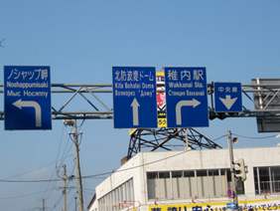
In Conclusion
The study of Language is as old as mankind
The study of language acquisition is approx 100 years old
We have many more questions than answers
We have new techniques, but do not always know exactly how best to use them and how to understand the results we get from them..
We have a job to do …

Slide 22
Thank You!

Slide 23
A Bit of History
Adult Second Language Acquisition
Early small scale project by individual teachers in individual classrooms (foreign language acquisition. Geared towards improving results and teaching itself)
First Large Studies with non-guided learners in the 1960s
  Non-guided learners; mainly immigrants; complex verbal tasks
  ZISA (Zweitspracherwerb Italienischer und Spanischer Arbeiter) Meisel et al.
  ESF Project Adult Immigrant Second Language Acquisition Perdue, Klein et al.
Experimental Studies Cross-sectional
  Theory-driven, interest in linguistic features
  Dulay & Burt; Watorek et al., Hendriks et al.
Cross-sectional studies of taught learners
  Classroom based, interest in language aptitude, motivation, sociolinguistic factors; based on data from exams

Slide 24
A Bit Of History
More Recent Studies
Simultaneous Bilinguals
Acquiring a Second Language at Young Age (before 6, 8 or 10)
The Acquisition of a Third, Fourth or Fifth Language
The Influence of the L2 on the L1
Language Attrition
Current methodologies
Production data, as before, free, through interview or experimental
Acquisition data experimental (i.e., through learning of artificial mini-languages)
“Big Data”

Slide 25
Typical level of Control of Factors (L1)
“A total of 200 subjects participated in the study. Subjects belonged to one of four language groups (English, French, German, Mandarin Chinese) and to one of four age groups within each language: children of approximately 5, 7, and 10 years, as well as control groups of adults (there were 10 to 20 subjects in each age group). The subjects came from schools and universities in Chicago (English), Paris (French), Köln (German), and Beijing (Chinese). They were tested in the setting of their school (children) or university (adults)”. Hickmann and Hendriks, in press.
Controlled: Age, Typological Differences
Attempt to Control: Socio-economic status (all children from same school); cognitive dev. Stage (asking for “middle of the group” children); Gender (half male, half female); Task

Slide 26
Typical level of Control (L2)
The 26 main informants for the ESF study were
Between the ages of 18 and 39 (Turkish informants youngest, Spanish informants oldest)
Stay in target country between 1 and 13 months at start of study
Source Language Schooling between 0 and 11 years
Target Language Schooling between 0 and +600 hours (Turkish in Germany most, Turkish in the Netherlands least)
Additional L3 for 9 informants (mostly rudimentary English).
“Ideal informants tend to exist in the heads of researchers. One does not meet them in the street.” Perdue, 1993

Slide 27
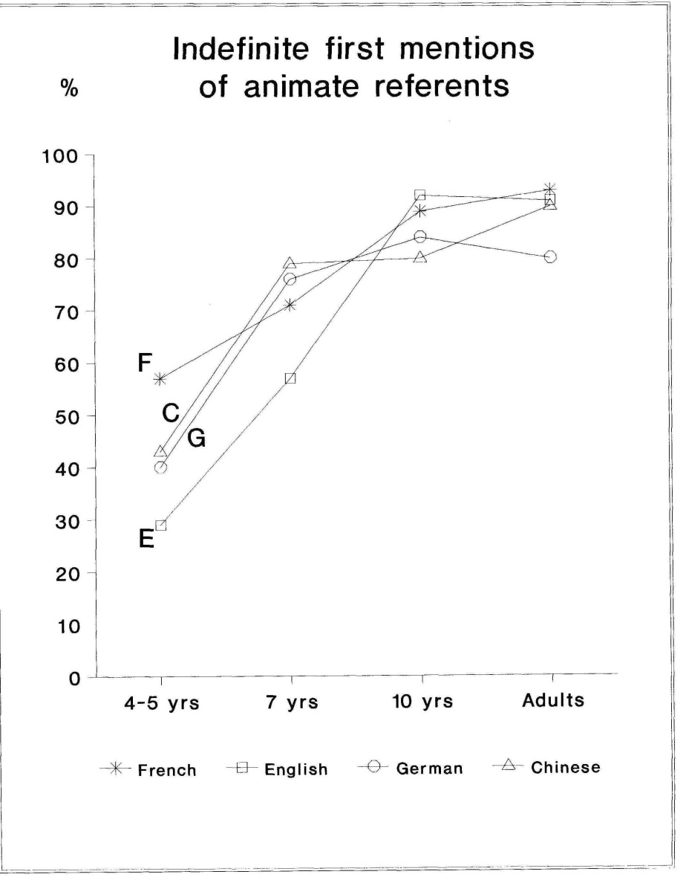
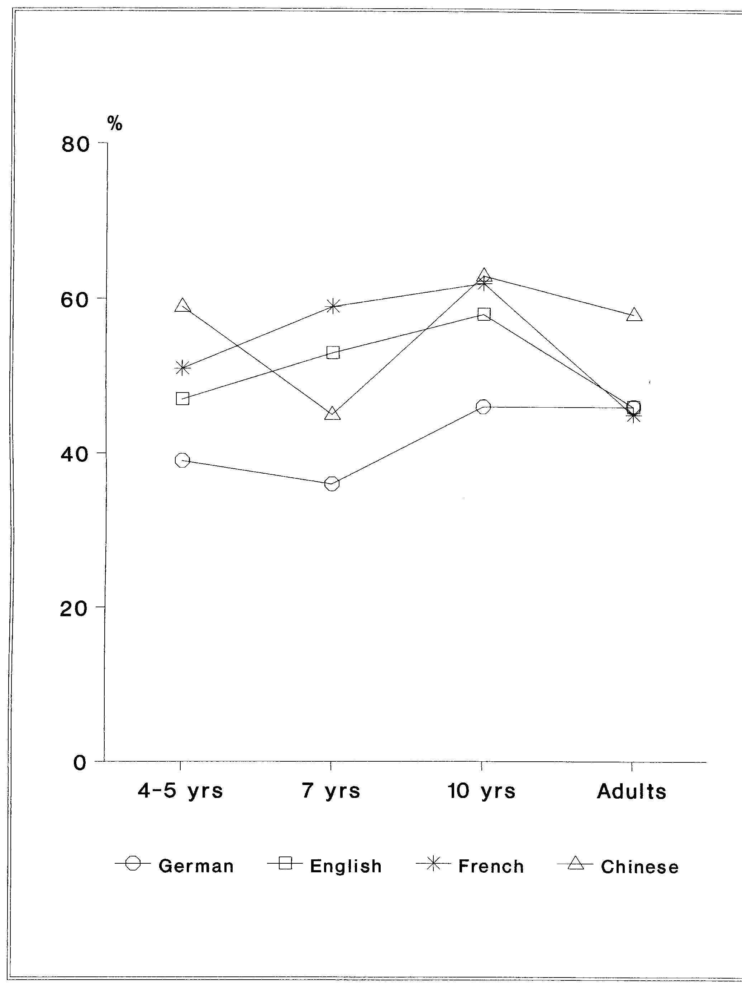
Cohesive reference (L1)
Appropriate markers subsequent mentions animate referents

Slide 28
Cohesive reference (L2)
Adults understand communicative situation, and correctly mark newness from earliest level of proficiency
Adults do not seem to use their knowledge of discourse pragmatic rules for the marking of given information

Slide 29
Questions to be answered:
Why are forms for reference maintenance acquired before forms for referent introductions?
  Original hypothesis: reference maintenance difficult to acquire, as need overview of textual coherence
  Is reference maintenance easy to acquire?
Why does it take children up to 7-10 years to acquire forms for marking new information?
  Original explanation: children fail to understand the notion of shared background information BUT
BUT
  Tomasello et al: "By at least 12 months of age [human] infants understand that actors actively choose means for pursuing goals… that others see things… [and] that actors choose to attend intentionally, for some reason, to some subset of the things they perceive" (Tomasello 2008:139).

