Slide 1

Neural predictions supporting speech comprehension
Matt Davis
MRC Cognition and Brain Sciences
Cambridge, UK

Slide 2
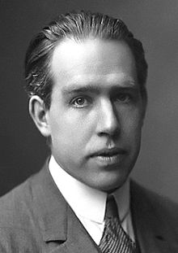
“Prediction is very difficult, especially about the future”
Niels Bohr (1885-1962)
Bastos et al. (2012, Neuron)

Slide 3
Predictions guide
speech comprehension
3. Resolving semantic ambiguity
1. Perceiving degraded speech
2. Recognising spoken words

Slide 4
1. Degraded Speech
Vocoded speech simulation of a cochlear implant
Neural responses to intelligible speech
Perceptual learning aids comprehension
Top-down predictive mechanisms

Slide 5
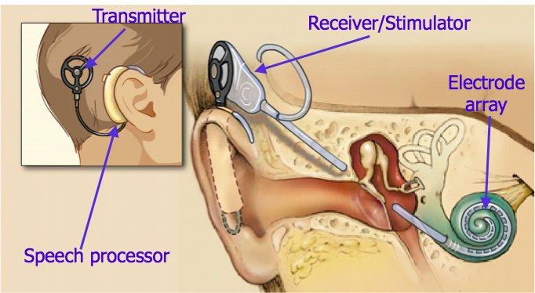
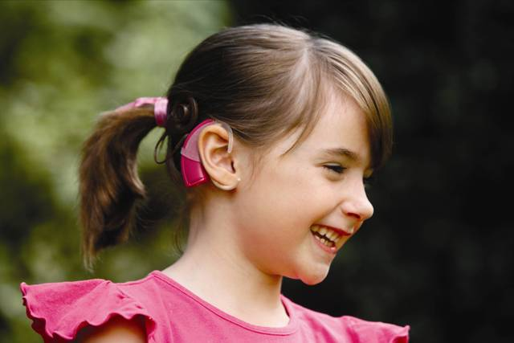
Simulation of a cochlear implant
Vocoded Speech

Slide 6
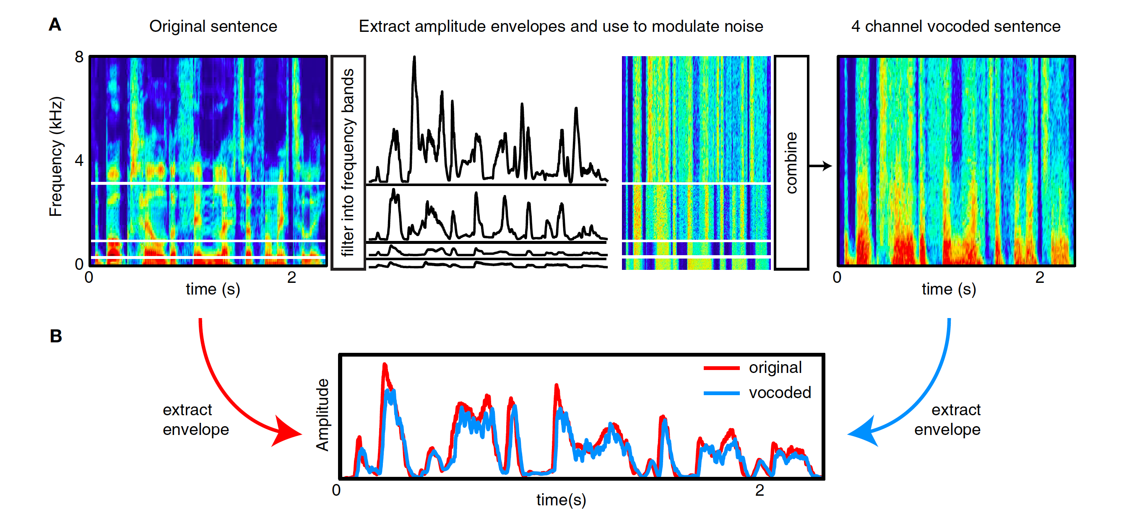

Simulation of a cochlear implant
Vocoded Speech
Shannon, Zeng, Kamath, Wygonski & Ekelid (1995, Science)
Figure from: Peelle & Davis (2012, Frontiers in Language Sciences)

Slide 7
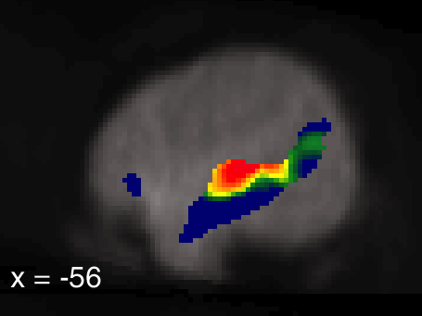
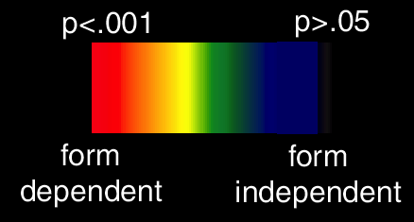
Brain areas responding to intelligible speech
Vocoded Speech
dorsal
ventral
Peelle & Davis
(2012, Frontiers in Language Sciences)
Davis & Johnsrude
(2003, J. Neuroscience)

Slide 8
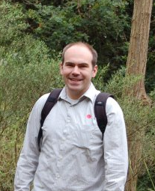
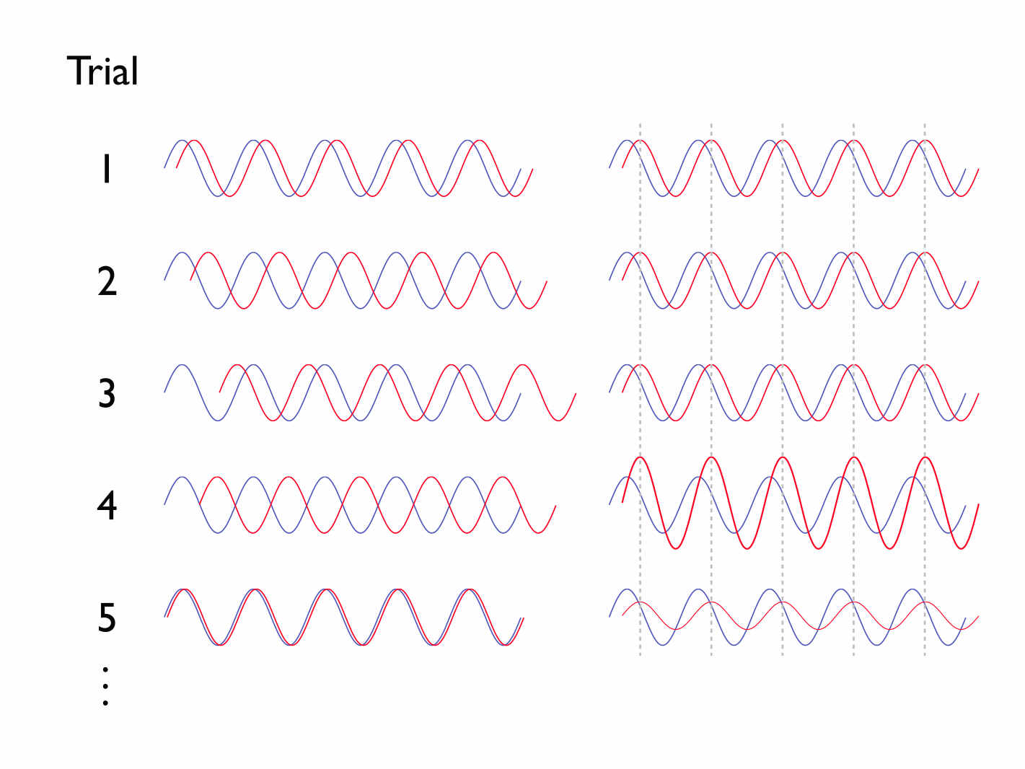
Neural responses to intelligible speech (MEG)
Vocoded Speech
Oscillatory coupling between speech and brain measured with
DICS
(Gross et al, 2000; 2001)
Low Coherence
High Coherence
Peelle, Gross & Davis (2013, Cerebral Cortex)

Slide 9
Neural responses to intelligible speech (MEG)
Vocoded Speech
4-7Hz oscillations in vocoded speech…
Peelle, Gross & Davis (2013, Cerebral Cortex)

Slide 10
Neural responses to intelligible speech (MEG)
Vocoded Speech
4-7Hz oscillations in vocoded speech and brain:
Peelle, Gross & Davis (2013, Cerebral Cortex)

Slide 11
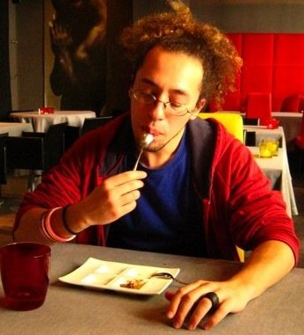
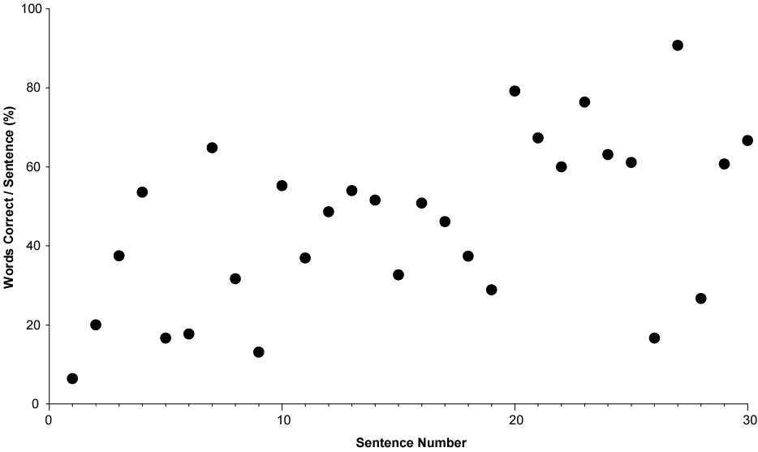

Perceptual learning
Vocoded Speech
Davis et al (2005, JEP: General) Hervais-Adelman et al (2008; 2011 JEP:HPP)

Slide 12
Perceptual learning
Vocoded Speech
Davis et al (2005, JEP: General) Hervais-Adelman et al (2008; 2011 JEP:HPP)

Slide 13

Perceptual learning
Vocoded Speech
Summary:
Enhanced by feedback on the content of speech
Retunes acoustic to phonological mappings
Involves top-down retuning
Semantic
Lexical
Phonological
Acoustic Input
-ve
connection strength
+ve
Davis et al (2005, JEP: Gen) Davis & Johnsrude (2007, Hearing Research)
Hervais-Adelman et al (2008; 2011 JEP:HPP)

Slide 14


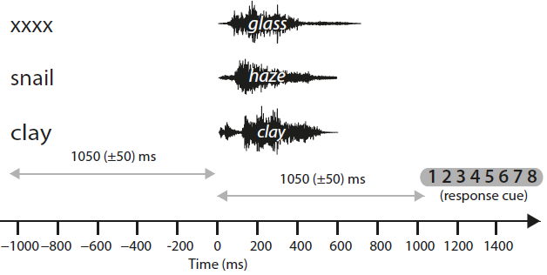
Predicting spoken words
Vocoded Speech
Sensory Detail
Low
Neutral
Prior knowledge
Medium
Mismatching
Matching
High
Sohoglu, Peelle, Carlyon & Davis (2012, J. Neuroscience)

Slide 15
Predicting spoken words
Vocoded Speech
Sensory Detail
Low
Neutral
Prior knowledge
Medium
Mismatching
Matching
High
Sohoglu, Peelle, Carlyon & Davis (2012, J. Neuroscience)

Slide 16
Predicting spoken words
Vocoded Speech
MEG shows temporal sequence of neural processes
Sohoglu, Peelle, Carlyon & Davis (2012, J. Neuroscience)

Slide 17
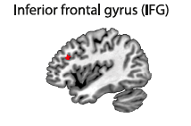
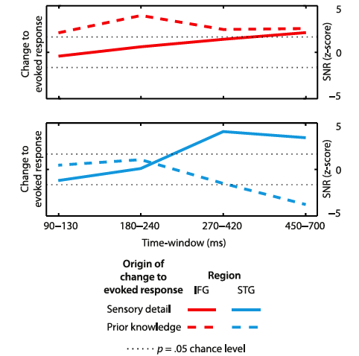
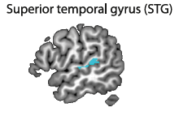
Predicting spoken words
Vocoded Speech
Sohoglu, Peelle, Carlyon & Davis (2012, J. Neuroscience)

Slide 18

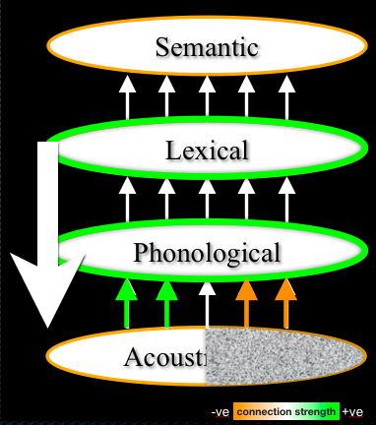
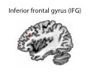

1. Vocoded Speech
Neural oscillations in the superior temporal gyrus entrain to intelligible speech
Top-down perceptual learning
assists speech understanding
Fronto-temporal, predictive
mechanisms contribute to perceptual analysis and
retuning

Slide 19
Predictions guide
speech comprehension
3. Resolving semantic ambiguity
1. Perceiving degraded speech
2. Recognising spoken words

Slide 20

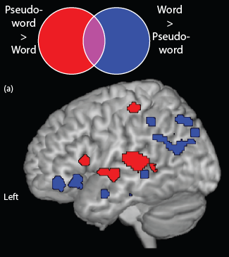
Spoken words/pseudowords
(meta-analysis,11 PET/fMRI studies)
Recognising words
dorsal
Davis & Gaskell (2009, Phil Trans B)
ventral
?

Slide 21
Recognising spoken words
(cf. Cohort / TRACE / etc)
Recognising words
“formu…
Blog
Fish
Force
Can
Formula
Format
Feed
Please
activation
Marslen-Wilson & Tyler (1980, Phil Trans B) McClelland & Elman (1986, Cog Psych)

Slide 22
Recognising spoken words
(cf. Cohort / TRACE / etc)
Recognising words
“formula”
Blog
Fish
Force
Can
Formula
Format
Feed
Please
activation
Marslen-Wilson & Tyler (1980, Phil Trans B) McClelland & Elman (1986, Cog Psych)

Slide 23
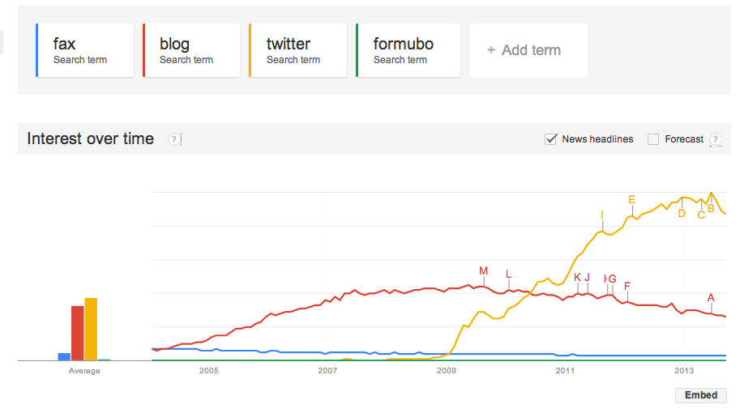
Learning a new word
Recognising words
http://trends.google.com/

Slide 24
Learning a new word
Recognising words
“formu…
Blog
Formubo
Fish
Force
Can
Formula
Format
Feed
Please
activation
Gaskell & Dumay (2003, Cognition)

Slide 25
Learning a new word
Recognising words
“formula”
Prediction:
Knowing formubo slows recognition of formula
Blog
Formubo
Fish
Force
Can
Formula
Format
Feed
Please
activation
Gaskell & Dumay (2003, Cognition)

Slide 26
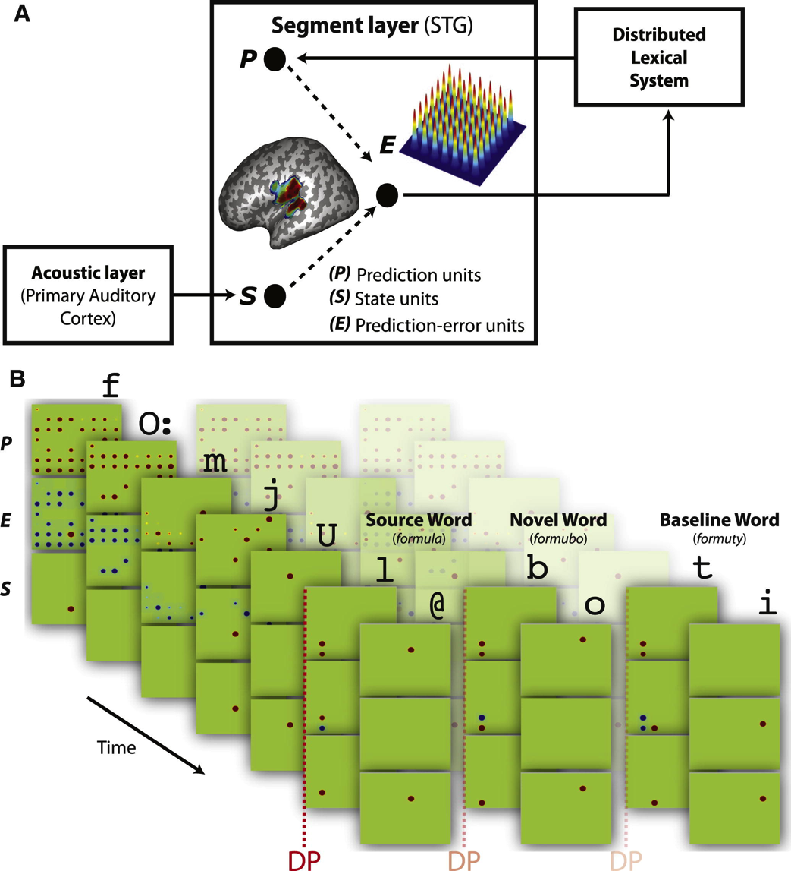
Predictive coding account of spoken word recognition
Recognising words
Superior Temporal Gyrus compares heard and predicted segments
Bayesian ‘ideal observer’ of spoken words simulates:
(1) Timing of word recognition
(2) Neural responses to novel and existing words
Learning a new word only modifies segment predictions after sleep
- Complementary (cortical/hippocampal) learning systems
Gagnepain, Henson & Davis (2012, Current Biology)

Slide 27
Predictions guide
speech comprehension
3. Resolving semantic ambiguity
1. Perceiving degraded speech
2. Recognising spoken words

Slide 28
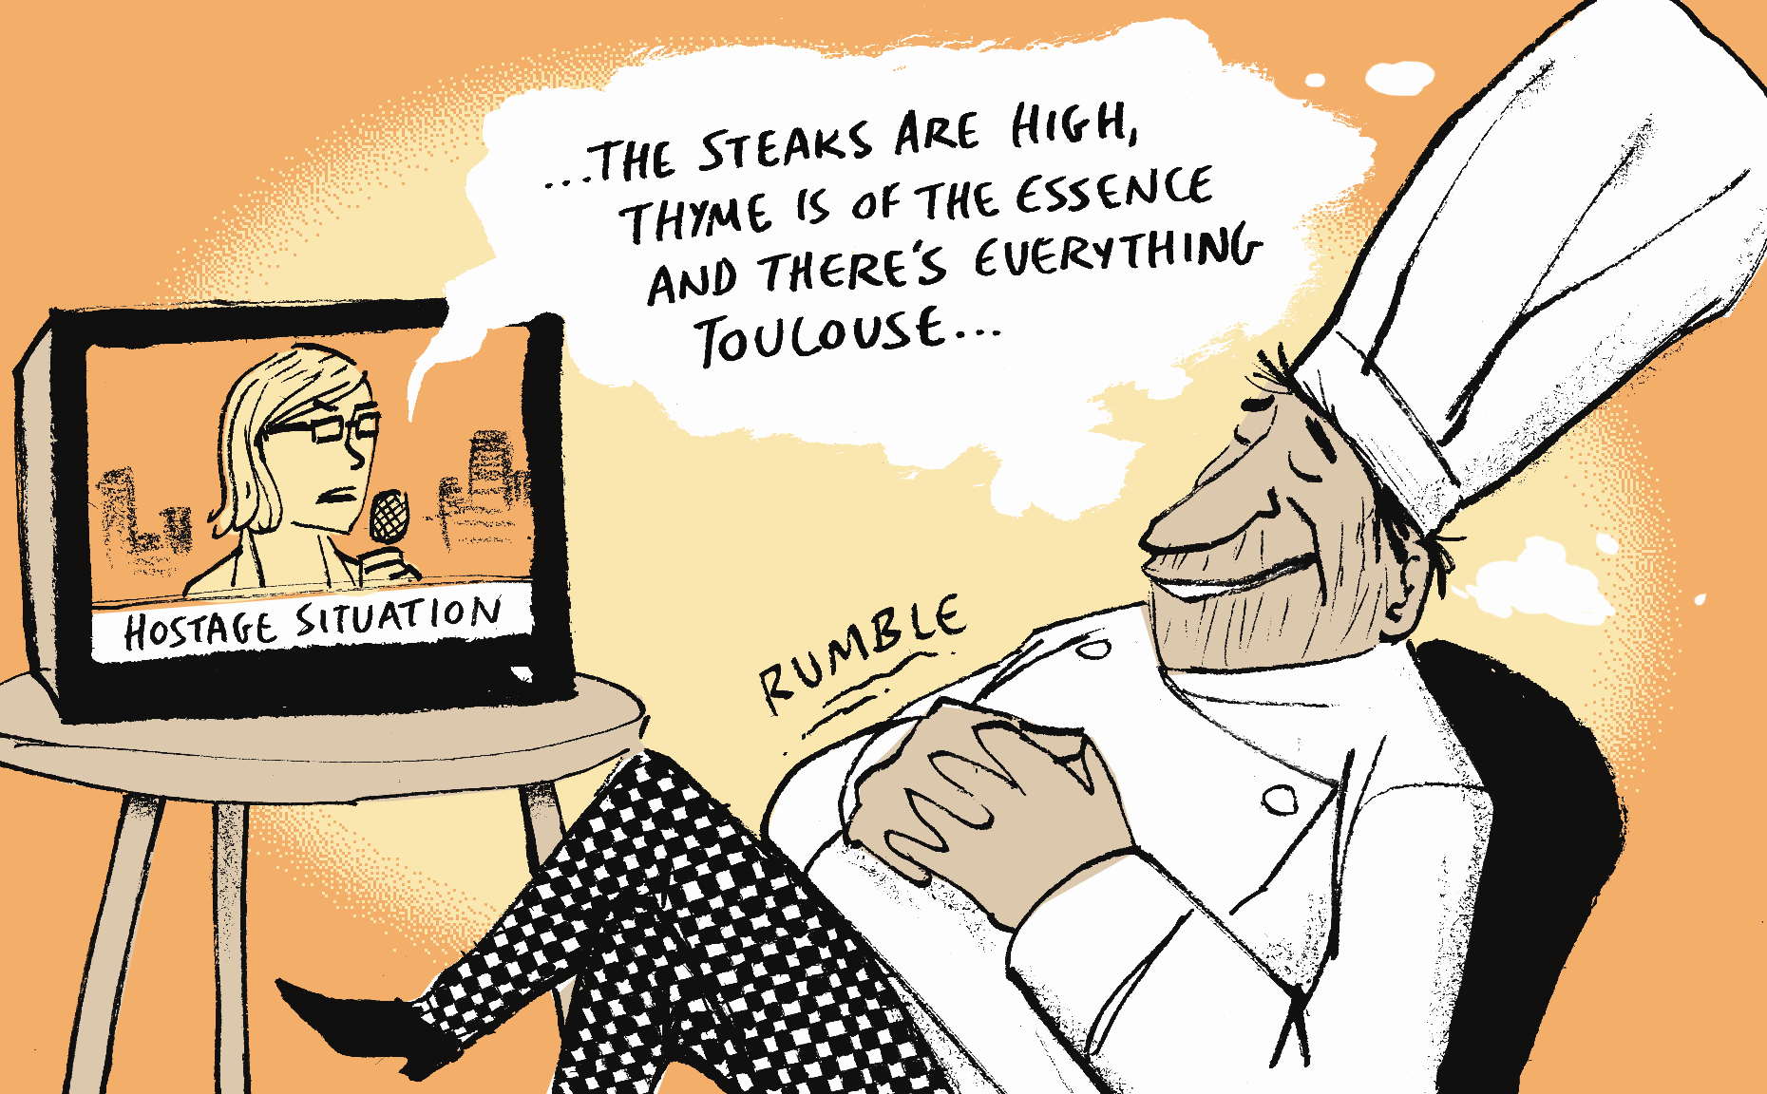
http://www.bergerandwyse.com/
3. Semantic
Ambiguity

Slide 29
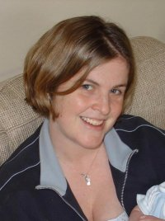
Ambiguity resolution as a neural marker of comprehension
Semantic Ambiguity
59 High ambiguity sentences
  “there were dates and pears in the fruit bowl”
  at least two ambiguous words / sentence
59 Low ambiguity sentences
  “there was beer and cider on the kitchen shelf”
  matched for: length, syntax, frequency, imageability, naturalness
Signal Correlated Noise (SCN) baseline
fMRI during active and passive listening
Rodd, Davis & Johnsrude (2005, Cerebral Cortex)

Slide 30
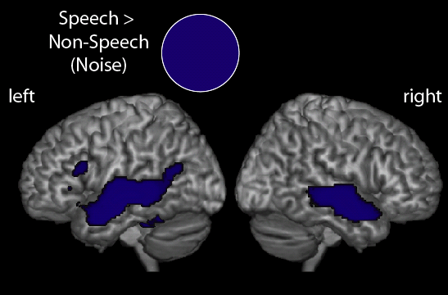
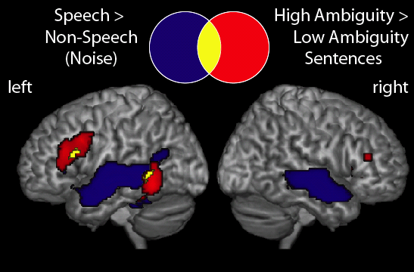
Ambiguity resolution as a neural marker of comprehension
Semantic Ambiguity
Rodd, Davis & Johnsrude (2005, Cerebral Cortex)

Slide 31
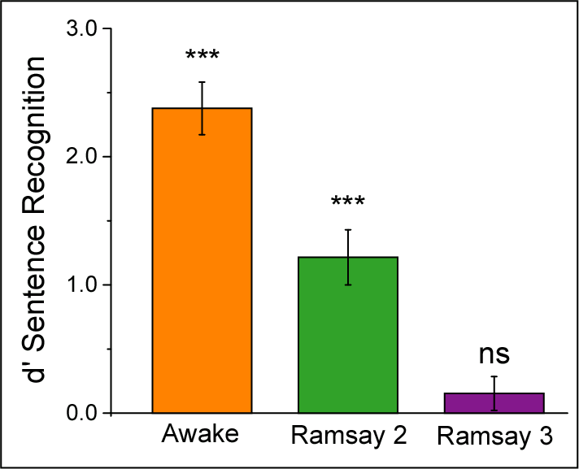
A neural marker of speech comprehension?
Semantic Ambiguity
Propofol (Diprifan) used for sedation and anesthesia
12 anesthetists listened
to sentences/noise whilst:
  Awake
  Lightly sedated
  Deeply sedated
Post-Sedation Memory
Awake
Light
Sedation
Deep
Sedation
Davis et al (2007, PNAS)

Slide 32
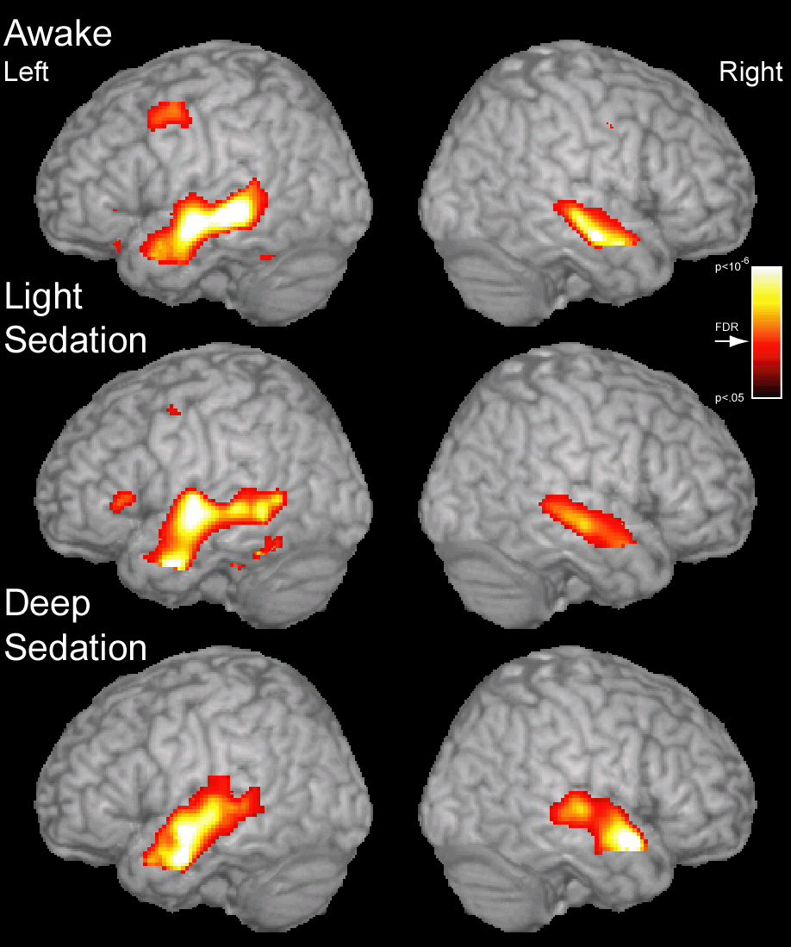
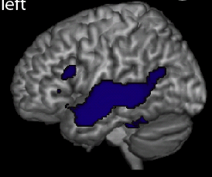
A neural marker of speech comprehension?
Semantic Ambiguity
Speech vs SCN (baseline)
Davis et al (2007, PNAS)

Slide 33
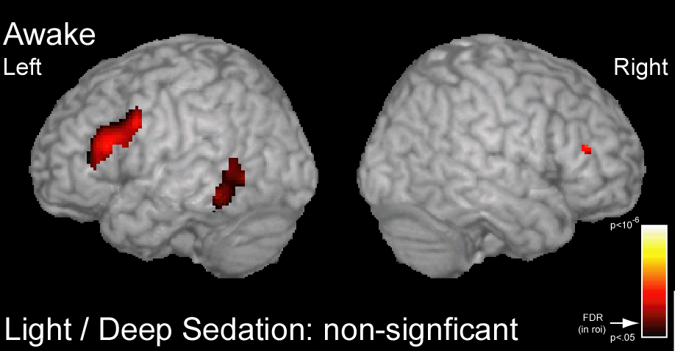
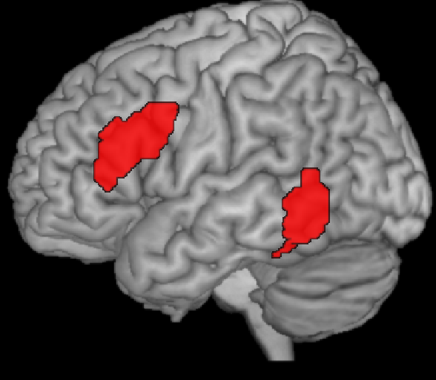
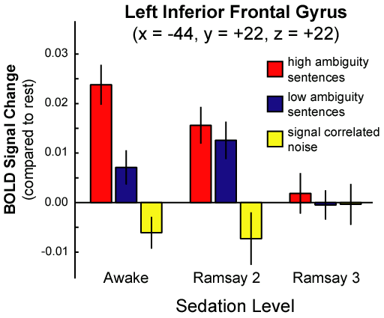
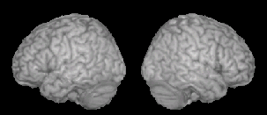
A neural marker of speech comprehension?
Semantic Ambiguity
High vs Low Ambiguity
Davis et al (2007, PNAS)

Slide 34

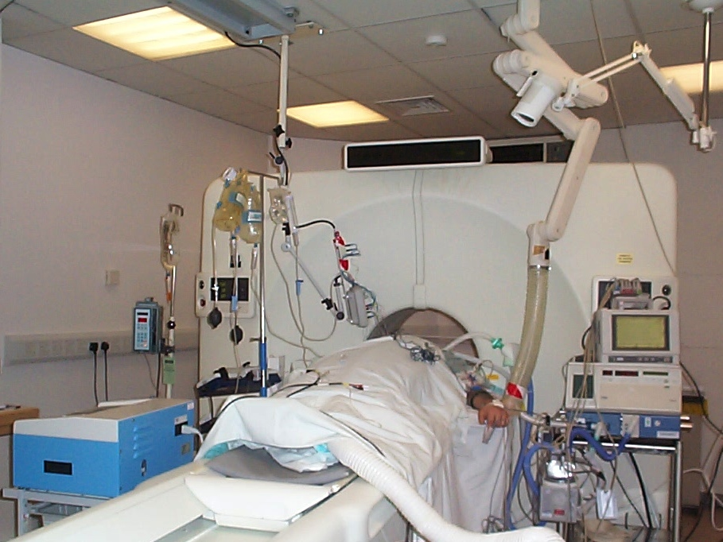
A neural marker of speech comprehension?
Semantic Ambiguity
Detecting awareness in vegetative patients:
A solution?
“Despite converging agreement about the definition of persistent vegetative state, recent reports have raised concerns about the accuracy of diagnosis… in a selection of cases, residual cognitive functions or even consciousness, may remain undetected”
Menon, Owen & Pickard (1999, Trends in Cognitive Science)

Slide 35
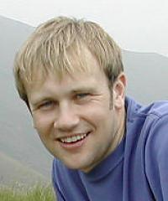
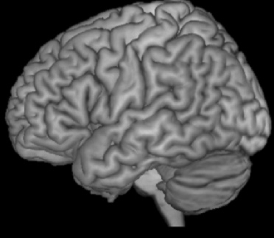
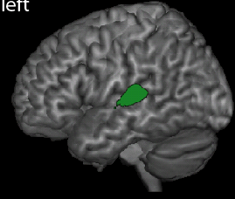
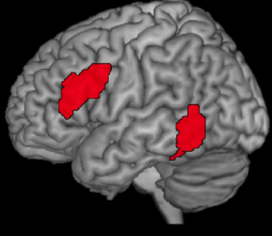
A neural marker for speech comprehension?
Semantic Ambiguity
18
MCS Traumatic
MCS Non-Traumatic
VS Traumatic
VS Non-Traumatic
16
14
12
Coma Recovery Scale Six Months Post-fMRI
10
8
6
N=38: rs = 0.81, p<0.001
4
2
0
Coleman et al.
(2009, Brain)
No
Response
Sound
Only
Speech >
Noise
High > Low
Ambiguity

Slide 36
Time-resolved fMRI (ISSS)
Semantic
Ambiguity
Conventional auditory fMRI shows where but not when
Acquiring multiple scans can distinguish early and late events in each sentence
0
5
10
15
20
25
Time (s)
Sentence
Scan volume
Schwarzbauer, Davis, Rodd & Johnsrude (2006, NeuroImage)
Notes:
Dummy scans maintain tissue magnetization between blocks (without gradient noise or data acquisition)

Slide 37
Prediction and ambiguity resolution
Semantic Ambiguity
Delayed Disambiguation
the ecologist thought that the plant by the river should be closed down
Immediate Disambiguation
the florist thought that the hares in the field were all extremely cute
Prior Disambiguation
the baker believed that the flour in the cake was all organically produced
Unambiguous
the hikers believed that the hills to the north were not very high
Ambiguous word
Ambiguous word
Ambiguous word
Rodd, Johnsrude & Davis (2012, Cerebral Cortex)

Slide 38
Prediction and ambiguity resolution
Semantic Ambiguity
Delayed Disambiguation
the ecologist thought that the plant by the river should be closed down
Immediate Disambiguation
the florist thought that the hares in the field were all extremely cute
Prior Disambiguation
the baker believed that the flour in the cake was all organically produced
Unambiguous
the hikers believed that the hills to the north were not very high
Disambiguation
Disambiguation
Disambiguation
Rodd, Johnsrude & Davis (2012, Cerebral Cortex)

Slide 39
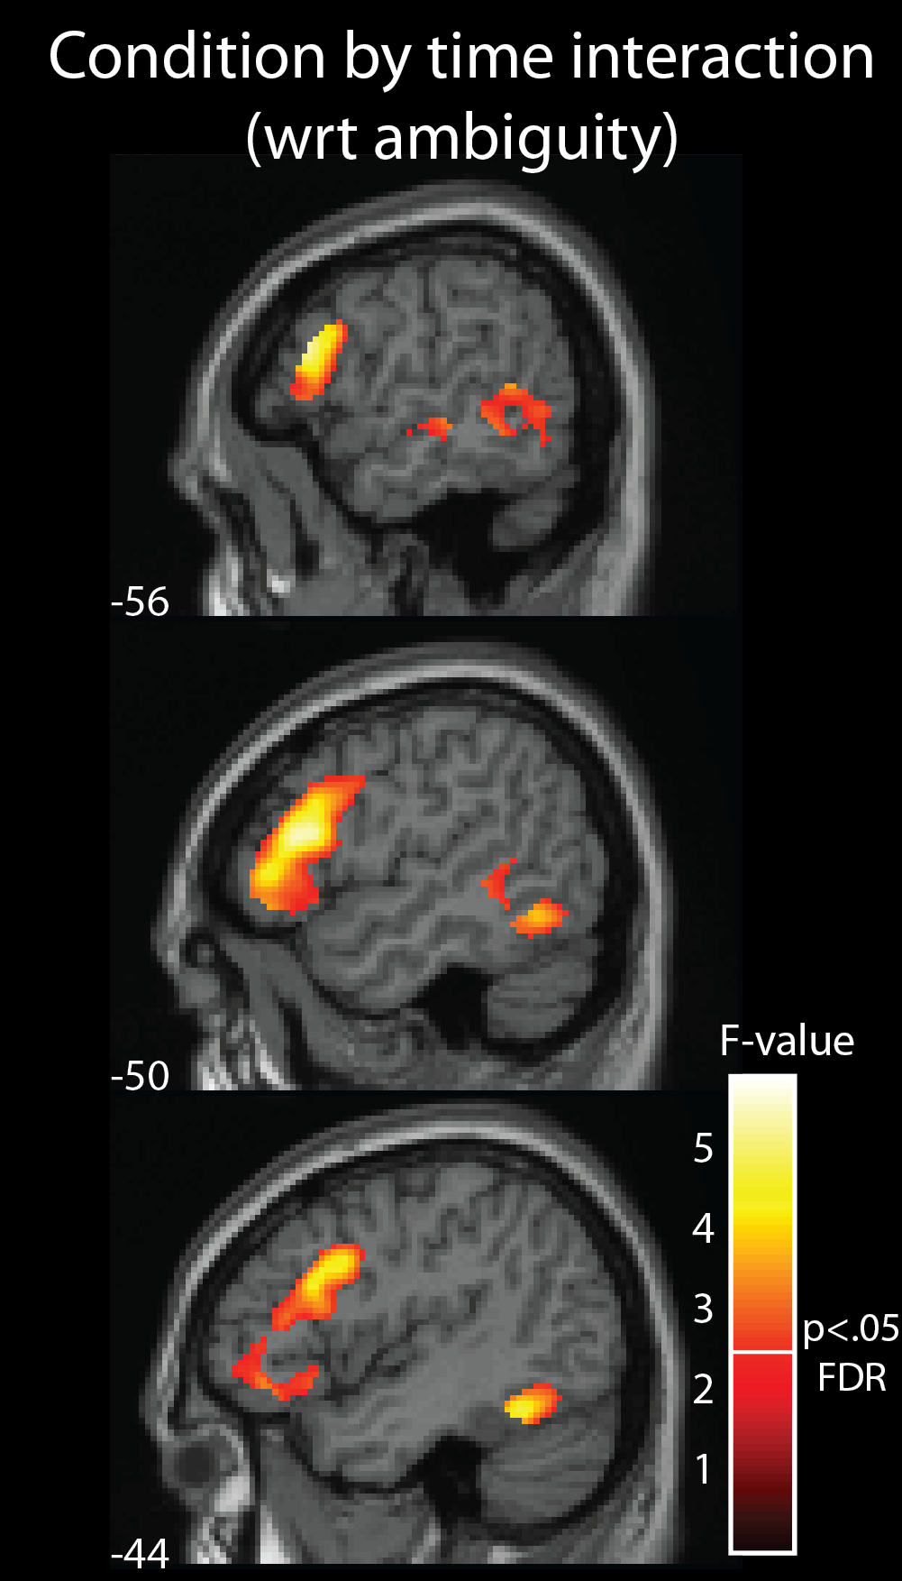
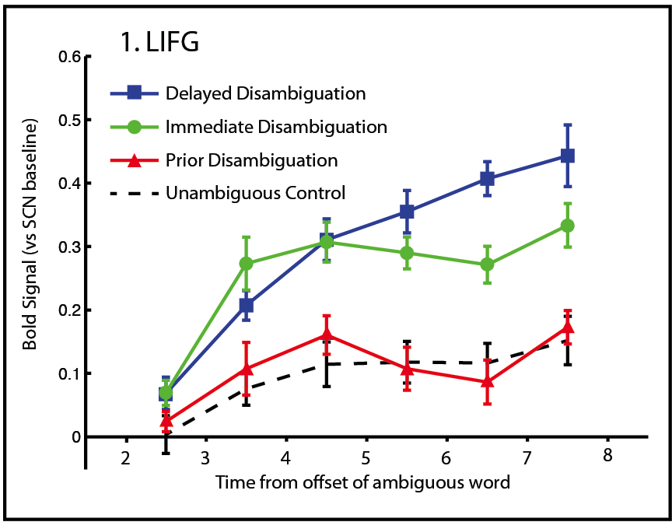
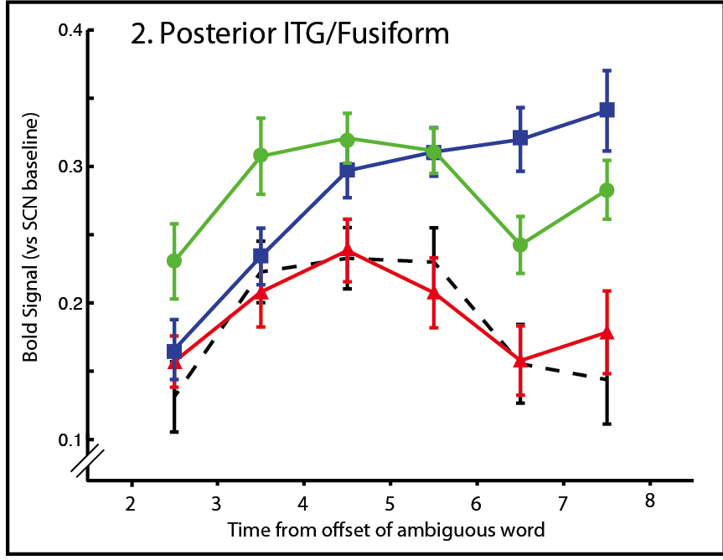
Prediction and ambiguity resolution
Semantic Ambiguity
Rodd, Johnsrude & Davis (2012, Cerebral Cortex)

Slide 40
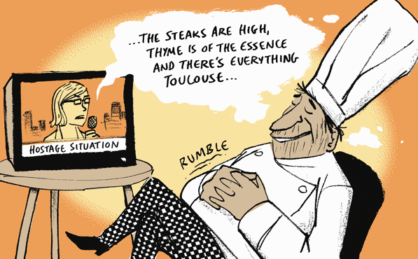


3. Semantic
Ambiguity
Ambiguity must be resolved for successful comprehension
Ambiguity responses are a marker for speech comprehension:
- in some vegetative patients
- but absent during sedation
- primarily for non-predicted
meanings
Ambiguity resolution leads to long-term changes in meaning preferences (retuning)
“bark”
Phonetic

Slide 41
Thank you:
Vocoded Speech:
Ingrid Johnsrude Queens Univ, Kingston, Canada
Alexis Hervais-Adelman Univ Geneva, Switzerland
Ed Sohoglu, Bob Carlyon MRC-CBU, Cambridge, UK
Jonathan Peelle Washington Univ, St Louis, USA
Joachim Gross Glasgow, UK
Word Learning:
Pierre Gagnepain, Rik Henson MRC-CBU, Cambridge, UK
Gareth Gaskell Univ of York, UK
Anna Maria Di Betta Univ of Sheffield, UK
Semantic Ambiguity:
Jenni Rodd University College, London, UK
Ingrid Johnsrude Queens Univ, Kingston, Canada
Adrian Owen Univ Western Ontario, Canada
Martin Coleman, David Menon WBIC, Cambridge, UK

