Slide 1
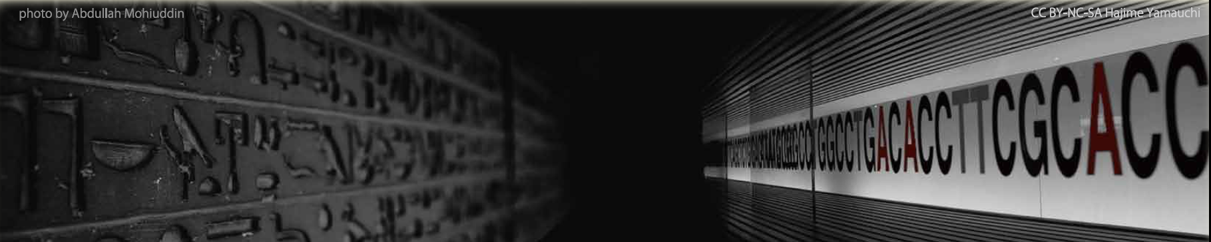




Language Sciences in the 21st century, Cambridge 3-4 October
One
minute madness
KEEP
CALM
AND
SPEAK
FASTER!

Slide 2
Language Sciences in the 21st century, Cambridge 3-4 October
KEEP
CALM
AND
SPEAK
FASTER!
Akira Murakami
Department of Theoretical and Applied Linguistics
University of Cambridge

Slide 3
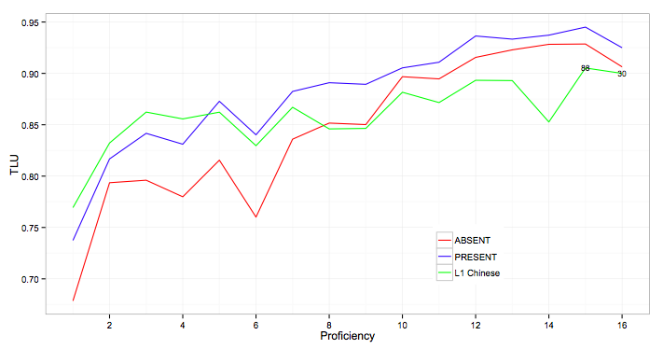
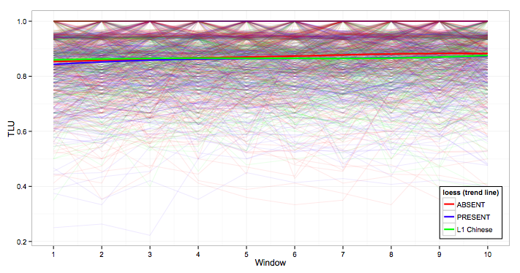
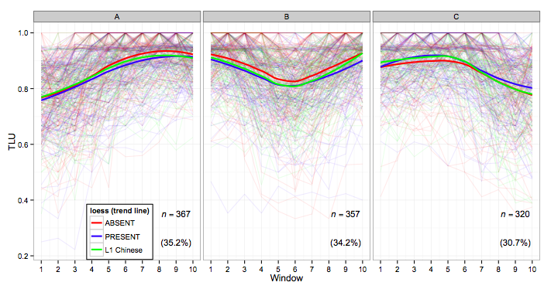
Accuracy development of the L2 English article
Pseudo-longitudinal
Accuracy increase
Longitudinal
Aggregated pattern of development
Flat
Clustering learners according to the shape of development
Multiple shapes
More fine-grained patterns of development

Slide 4
Language Sciences in the 21st century, Cambridge 3-4 October
KEEP
CALM
AND
SPEAK
FASTER!
Maria Kunevich
Department of Theoretical and Applied Linguistics
University of Cambridge

Slide 5


Learners’ grammar development: the interactions between phonology, information structure, and discourse
Maria Kunevich
msk41@cam.ac.uk
L2 English
L1 Russian
L1 Italian
Nuclear stress
Discourse organisation
Intonation
Information structure
Perception and production data
Corpus-based research

Slide 6
Language Sciences in the 21st century, Cambridge 3-4 October
KEEP
CALM
AND
SPEAK
FASTER!
Chris Fresch
Faculty of Divinity
University of Cambridge

Slide 7
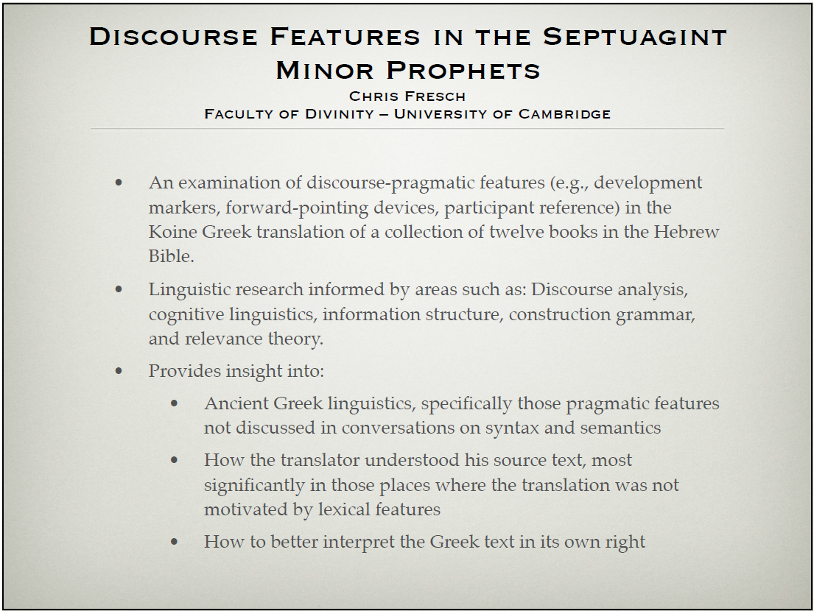

Slide 8
Language Sciences in the 21st century, Cambridge 3-4 October
KEEP
CALM
AND
SPEAK
FASTER!
Christian Bentz
Department of Theoretical and Applied Linguistics
University of Cambridge

Slide 9
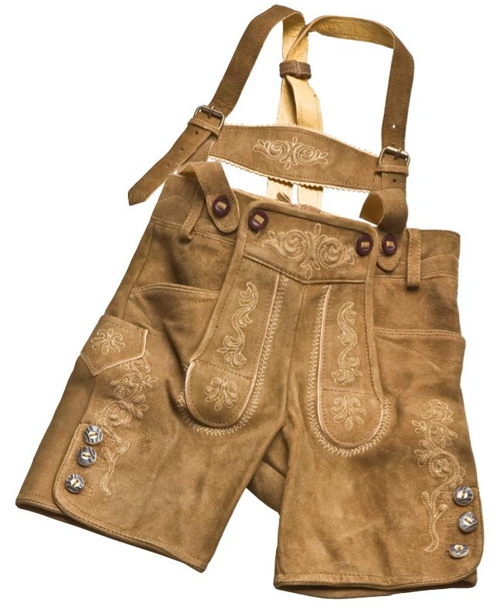


?
die Lederhose
der Lederhosenhalter
die Lederhosenhalterschnalle
Synthetic
Quantitative measure
The buckel for the straps on the leather shorts
the straps on the leather shorts
the leather shorts
Analytic
?
?
Cross-linguistic comparison
Factors of change
Poster
Zipf’s law and the grammar of languages
Christian Bentz
Department of Theoretical and Applied Linguistics
University of Cambridge

Slide 10
Language Sciences in the 21st century, Cambridge 3-4 October
KEEP
CALM
AND
SPEAK
FASTER!
Georg Höhn
Department of Theoretical and Applied Linguistics
University of Cambridge

Slide 12
Language Sciences in the 21st century, Cambridge 3-4 October
KEEP
CALM
AND
SPEAK
FASTER!
Jessica Soltys
Department of Theoretical and Applied Linguistics
University of Cambridge

Slide 13
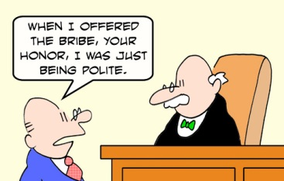
Politeness and off-record indirectness
I realise you're under pressure, officer, but there's no-one around, and it can't be worth your time to deal with this, when there's lots of paperwork and, well...
Sir, there is no possibility that you might be able to help me, is there?
?
Perhaps I could pay an on-the-spot fine?
Jessica Soltys jms256@cam.ac.uk

Slide 14
Language Sciences in the 21st century, Cambridge 3-4 October
KEEP
CALM
AND
SPEAK
FASTER!
Yan Tao
Department of Theoretical and Applied Linguistics
University of Cambridge

Slide 15
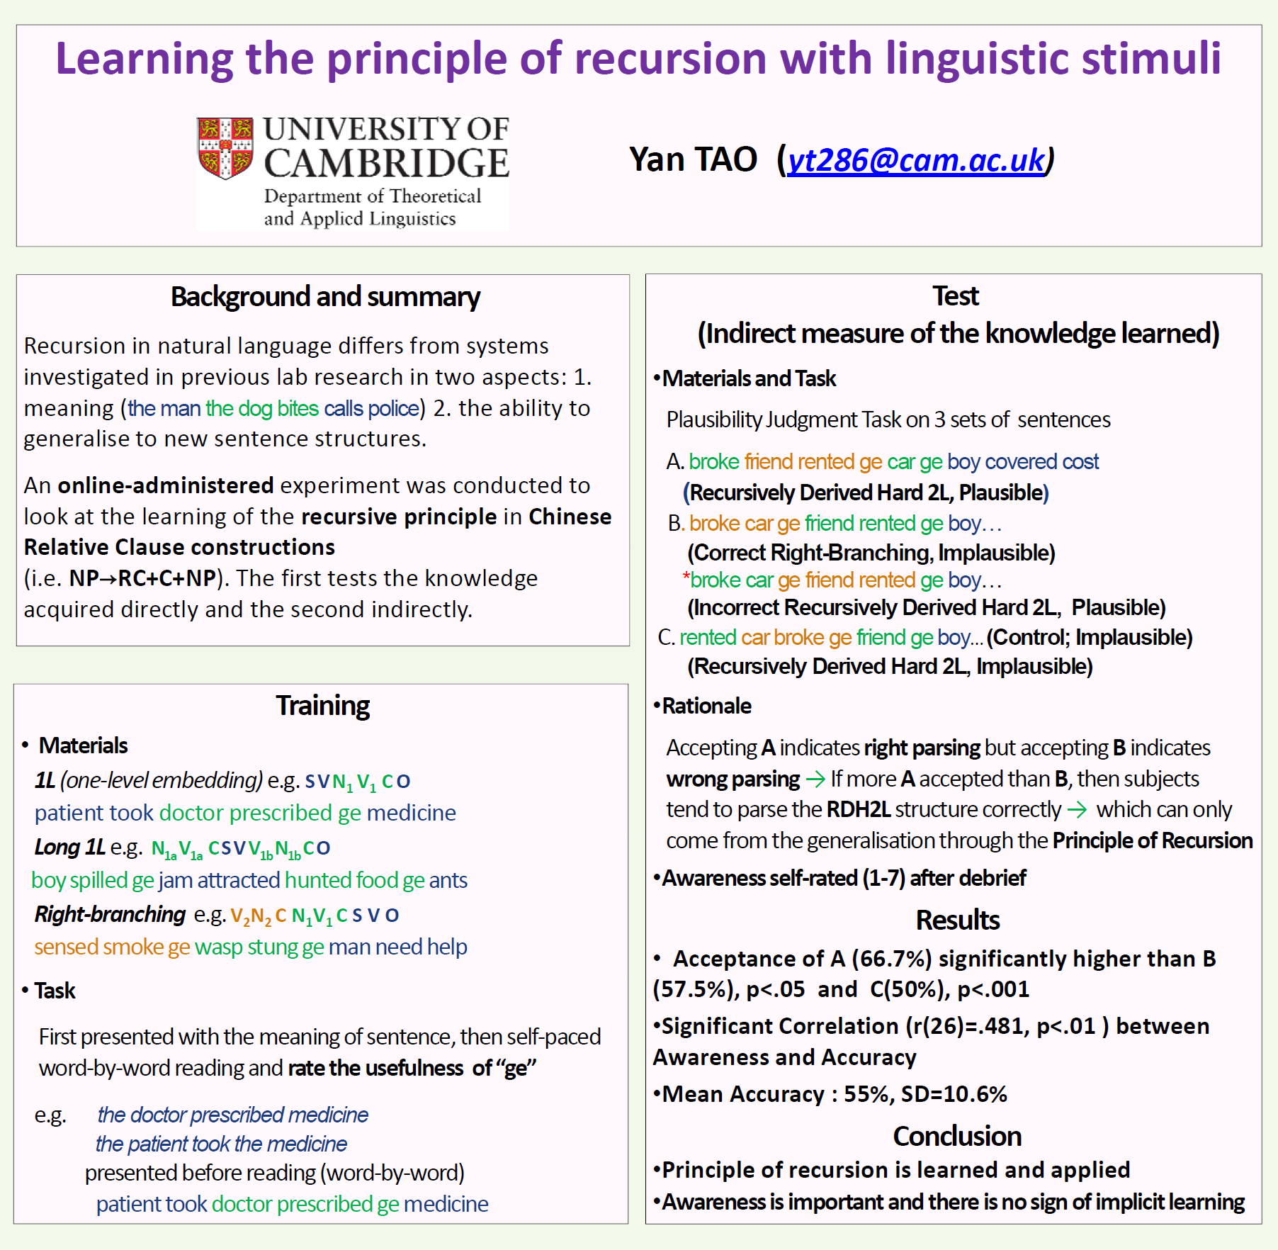

Slide 16
Language Sciences in the 21st century, Cambridge 3-4 October
KEEP
CALM
AND
SPEAK
FASTER!
Felix Hill
Computer Laboratory
University of Cambridge

Slide 17
Language Sciences in the 21st century, Cambridge 3-4 October
Thanks…
for your 8 mins of attention!

