Slide 1
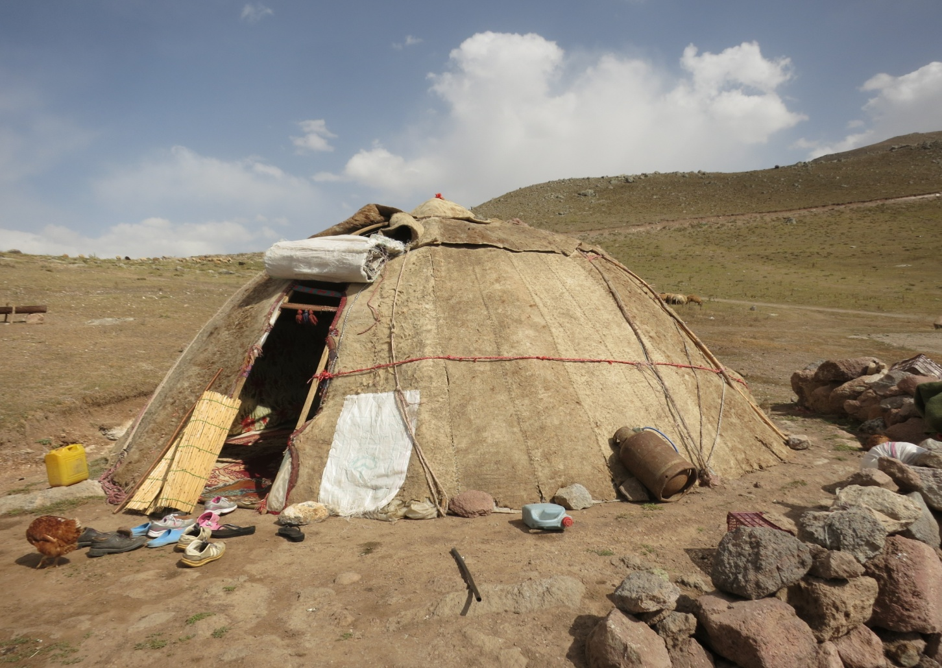
Unity and diversity in Turkic evidentials Elisabetta Ragagnin Faculty of Asian & Middle Eastern Studies University of Cambridge

Slide 2
Evidentials world-wide
....and across Turkic languages

Slide 3
Turkic language family
Typological profile
Geographical distribution (number of languages, standard and varieties)
Time depth (VIII first documents discovered in Mongolia)
Aspect/tense/mood
Evidentiality
Language contact

Slide 4
Turkic evidentiality: a Definition

Slide 5
Marking strategies of evidentiality
Verbal suffixes
Particles of copular origin

Slide 6
Simple system
Opposition indirective vs. Non indirective
E.g. Turkish: -mIš vs. –DI
#####
#####

Slide 7
Copulas oppositions
imiš vs idi

Slide 11
Turkic „eastern“ languages
More developed systems

Slide 12
Modern Uyghur
-(X)ptu (often in extremely developed phonetical shape) expresses indirectivity; eg. (p. 139):
aˀtnï min-i uču kit-tu bu
horse-acc ride-cb fly-postV-Evid this
‘(He) immediately left (the palace), and flew away riding his horse.’

